Slide 1

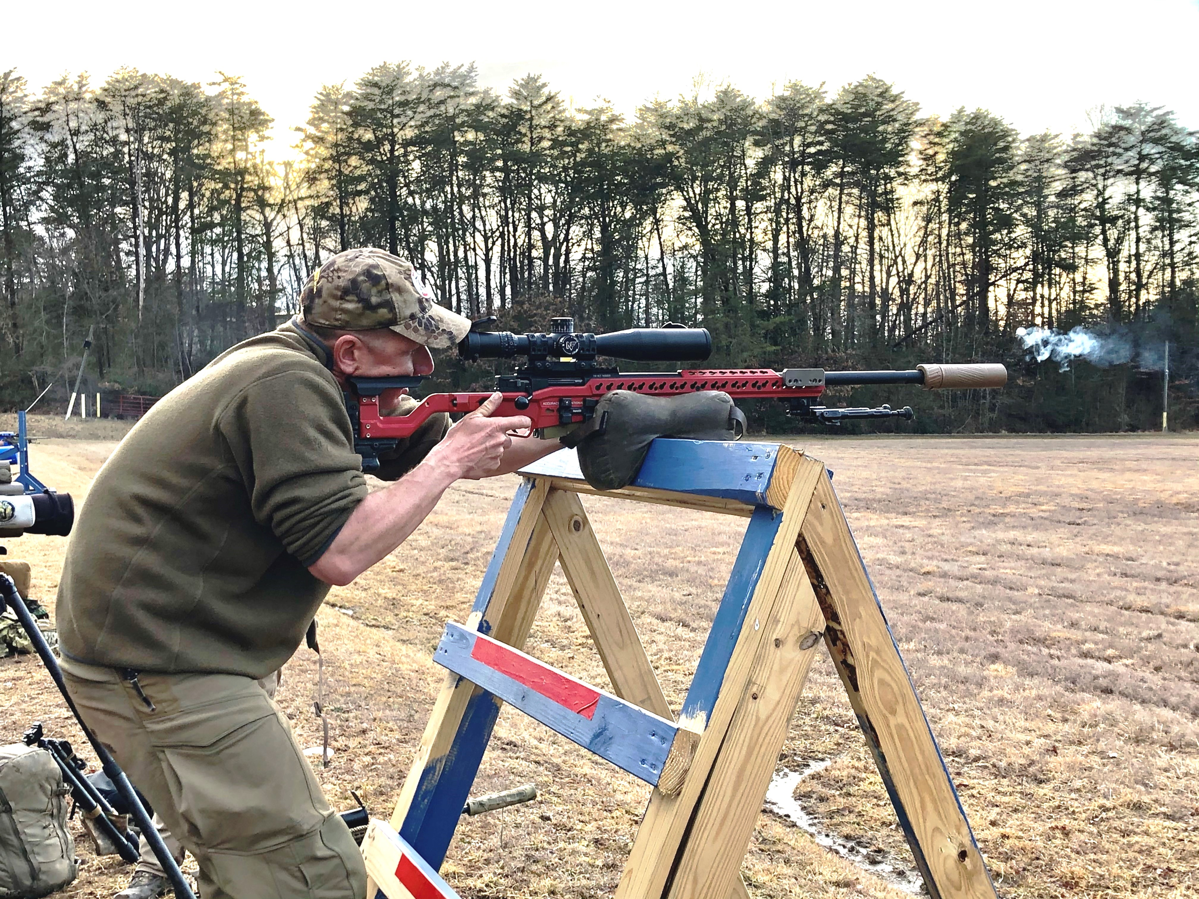
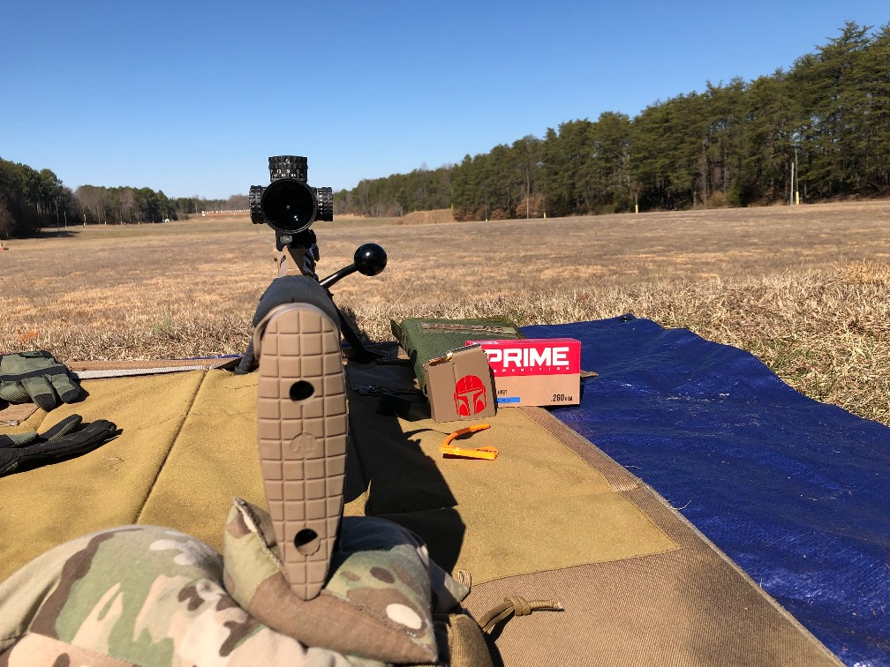
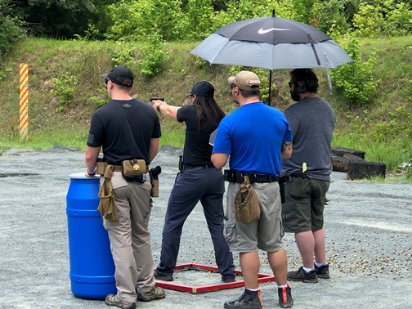
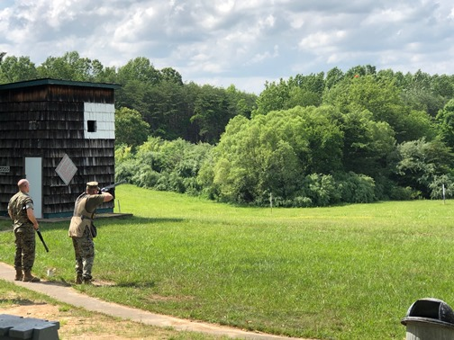
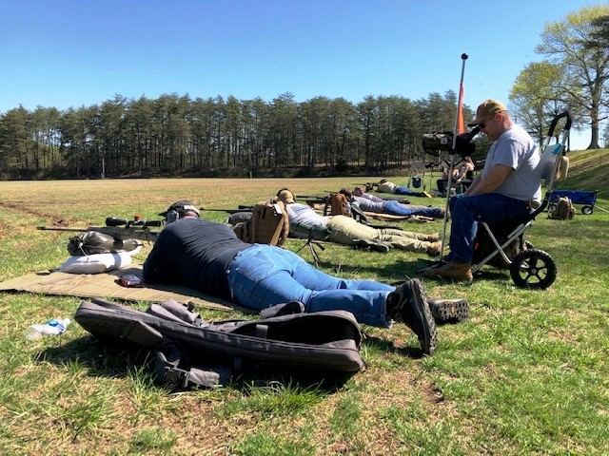
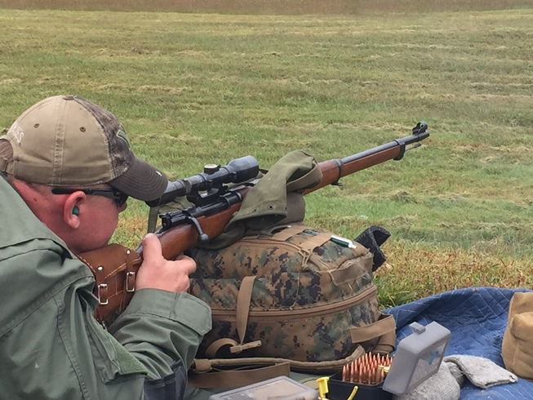
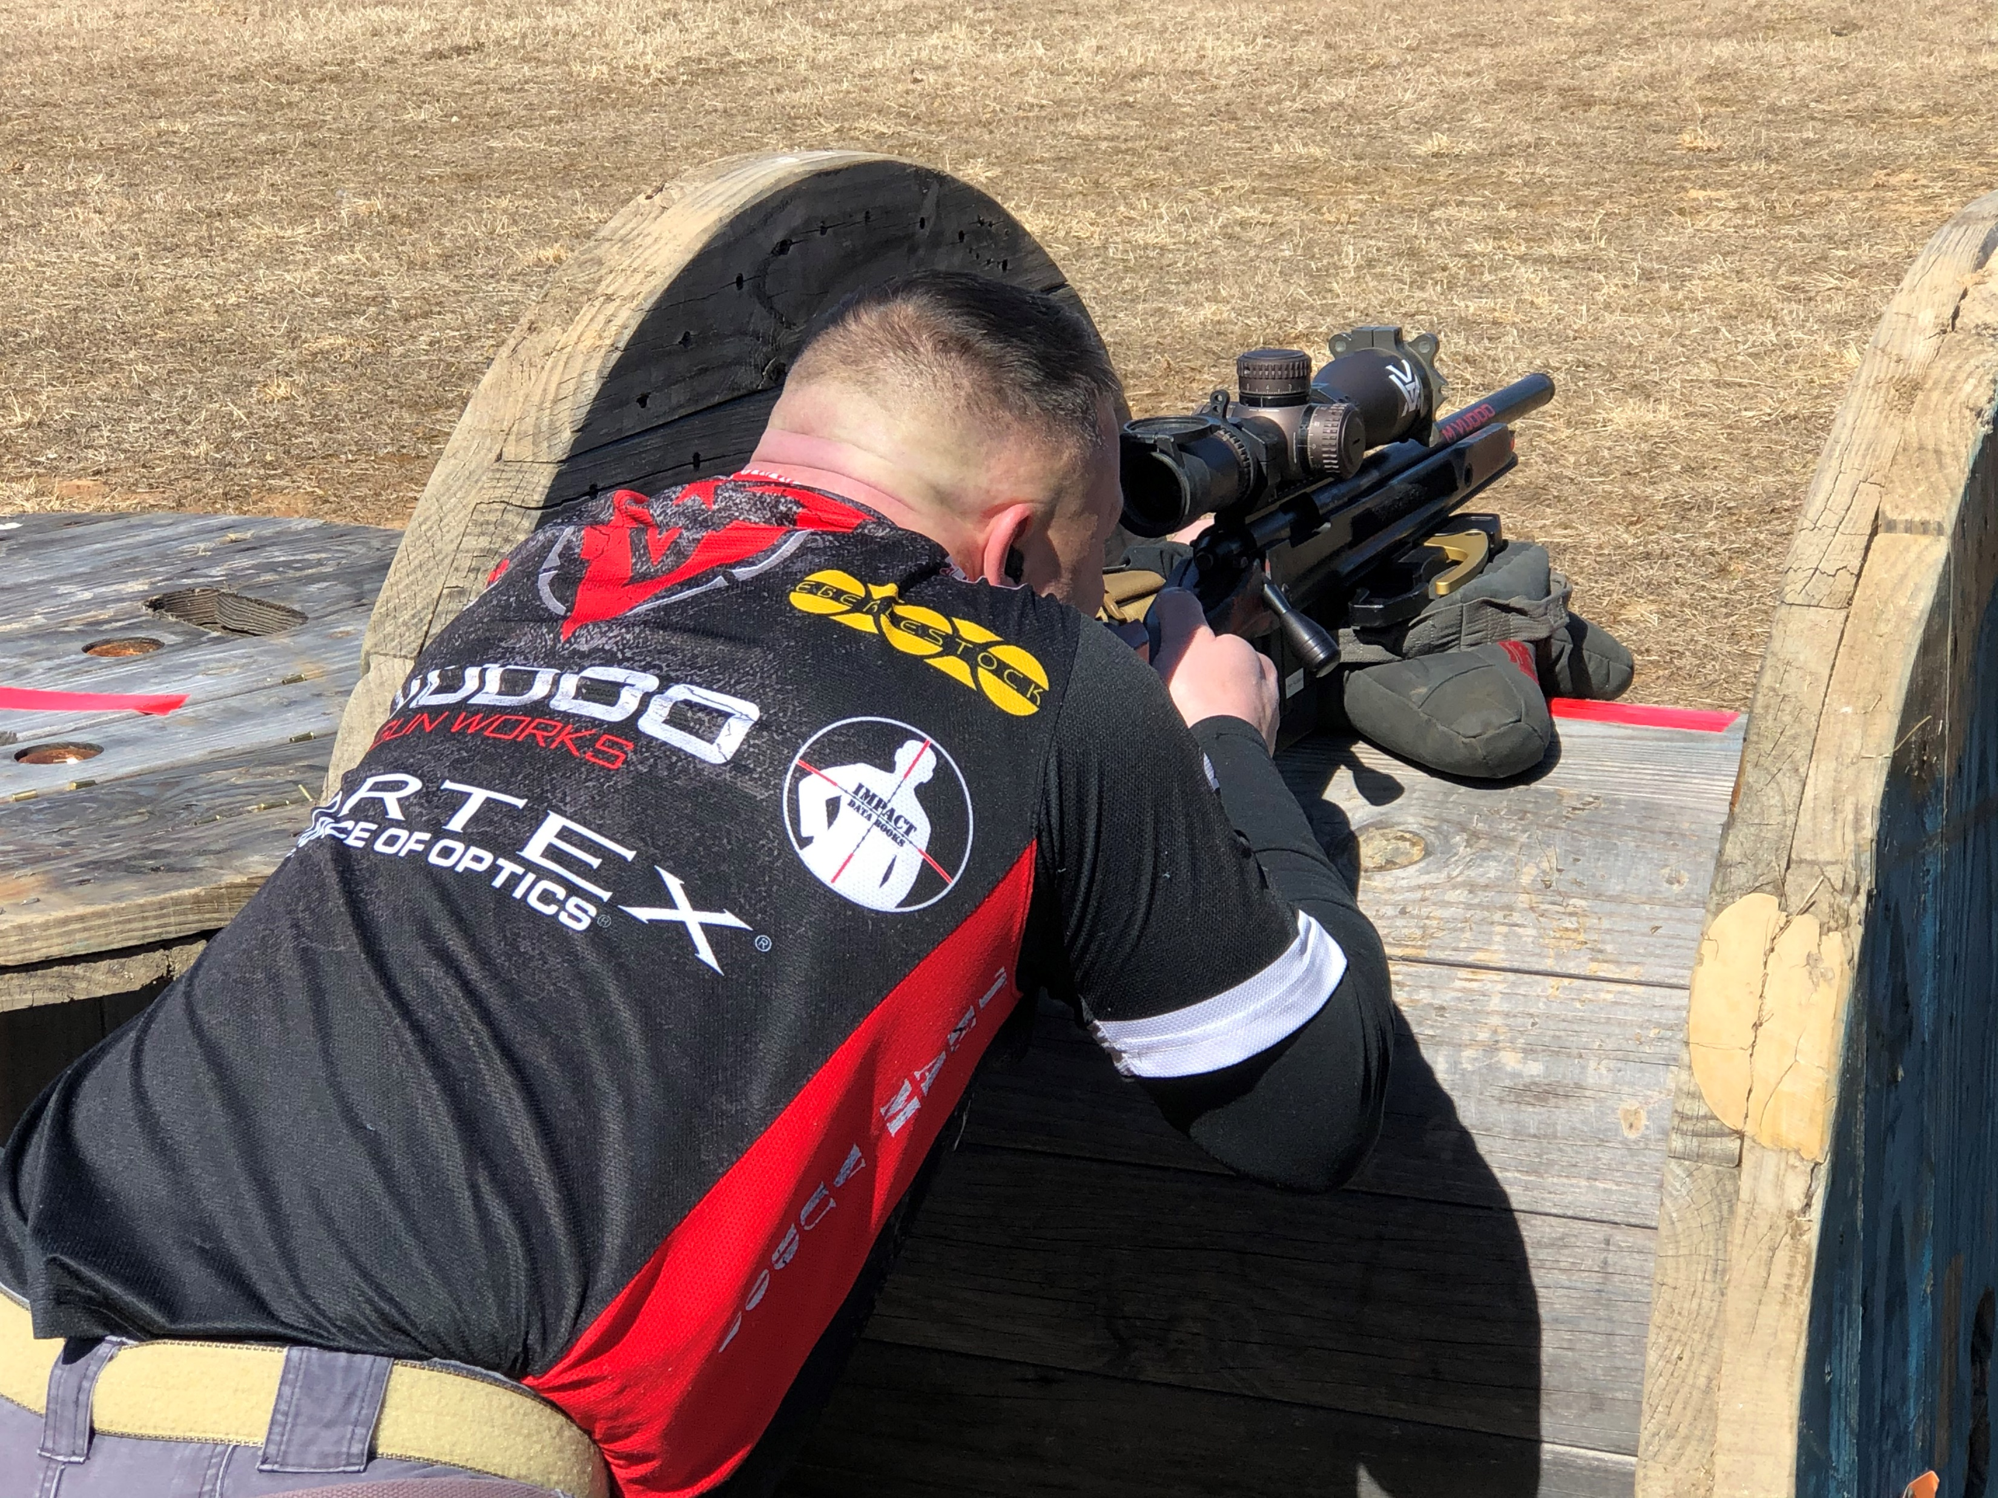
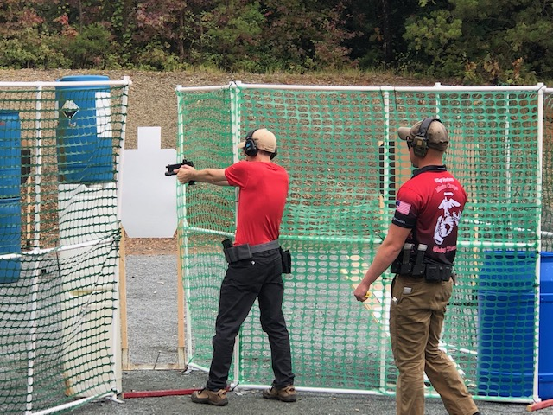
Quantico Shooting Club 2nd Quarter Member Meeting-2021
7/17/2021
Quantico Shooting Club

Slide 2
QSC 1st Quarter Member Meeting Agenda – April 17, 2021
Welcome
Special Presentations
Business Operations
Old Business
  Acceptance of previous Meeting Minutes
  Ongoing & BoD Activities
New Business
  BoD Activities
  Operations Report
  Secretary’s Report
  Treasurer’s Report
  RSO Report
  Match Report
  Match Director Comments
  Open Forum
7/17/2021
Quantico Shooting Club
1

Slide 3
Special Presentation
QSC’s success is due to our many members who serve as RSOs, assist with the recurring and unique work parties, provide their expertise, serve as range directors, etc., etc.
We’d like to recognize members who have stepped up from our many volunteers with a small token of our appreciation for their dedication and leadership:
  Jillian McAllister – RSO and assists with USPSA
  Jay Hart – RSO and range mentor
  Peter Moons – RSO and assisted with many Rec Fire ranges
  Kevin Shannon – RSO and Steel Challenge Lead
  Keith Minard – PRS Rimfire and Course of Fire Designer
  Jeff Ludwig – RSO, Shotgun RSO and Shotgun Field Improvements
The Board has approved a lifetime membership for Steve Mullins for his continued dedication to the club
The Board conveys our deepest appreciation for Mark Drinkwater’s years of service to the club!

Slide 4
Business Operations – Board Vacancy
Mark Drinkwater stepped down as President of the club in June
  Per the By Laws, Clint Anderson assumed the position of President and will fill the slot for the remainder of Mark’s term (the next scheduled annual elections)
  Trevor Chaplick, the former Treasurer, volunteered to become the Vice President
    Per the By Laws, and with a majority of the Board in favor, the Board accepted and installed Trevor for the remainder of the term
7/17/2021
Quantico Shooting Club
3

Slide 5
Old Business – Secretary
Reading of the previous Minutes
Acceptance of previous meeting’s minutes
7/17/2021
Quantico Shooting Club
4

Slide 6
Old Business – Ongoing Activities
Some of the projects we continue to work or assess:
SAMPLE OF ONGOING BOARD PROJECTS
Ongoing – Establish Match Chairs and provide $1,500 budget | Ongoing – Asset Inventory – Requires total update - 2021 | Ongoing – Implement / Approve longer QSC Officer Terms
Ongoing – Analyze renewals to determine why members depart | Ongoing – Simplify - Too many touch points and manual processes | Ongoing – Considering updating Bylaws
Ongoing – Drafting updated RSO Training

Slide 7
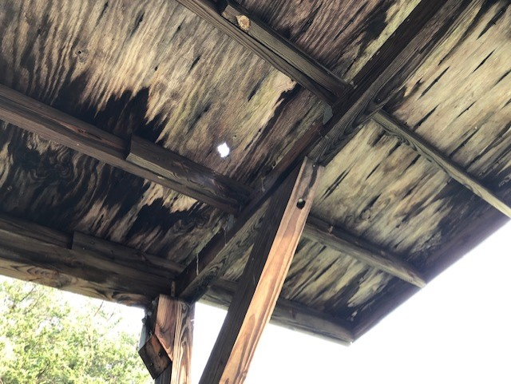
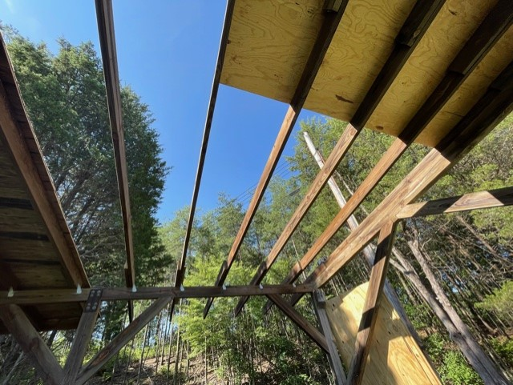
Old Business – International Bunker
Covered facility’s roof structure in desperate need of repair
  Supporting structure solid but roof is original and water intrusion has rotted the sheathing
UPDATE – Roof is under repair as of July 13th – Slow going with the hot weather

Slide 8
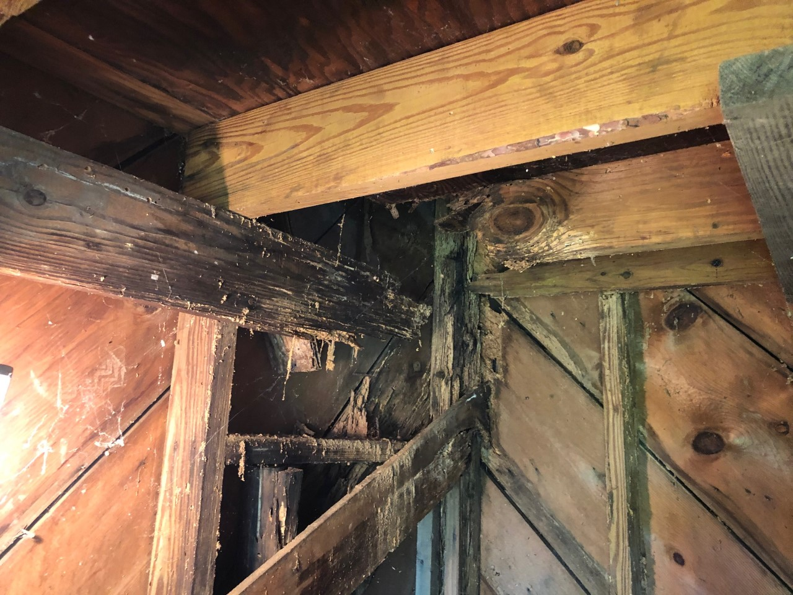
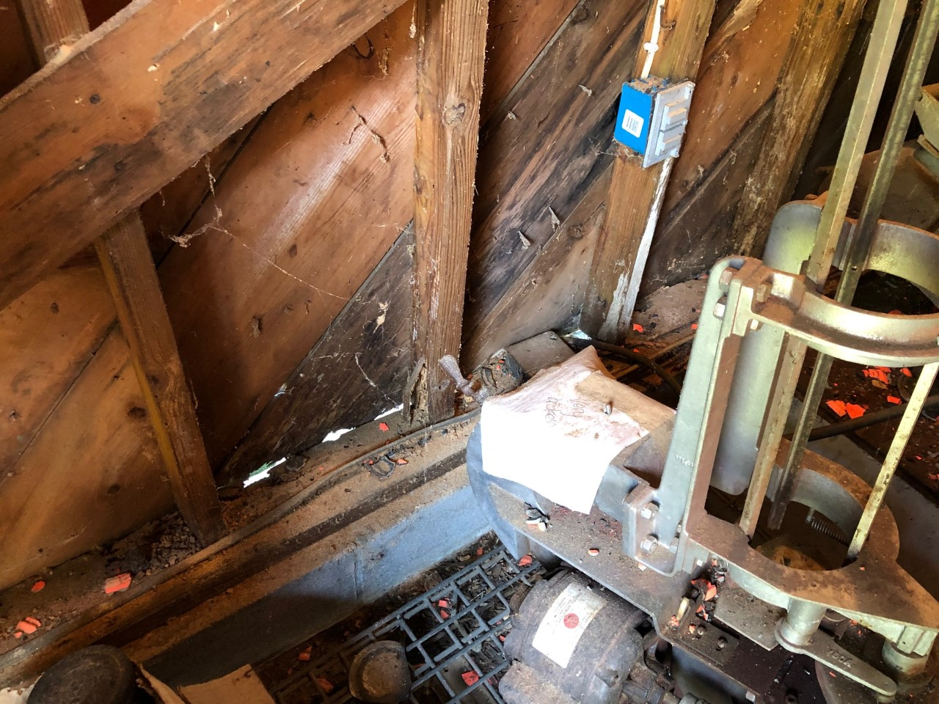
Old Business – Skeet House 4
Corner support and 2nd floor’s joists eaten by termites – also has water intrusion
MCBQ facilities surveyed the house – QSC emphatic, don’t condemn house
  Facilities highly suggested self-help
UPDATE – House may be condemned and torn down unless we commit substantial funds to rebuild – Repair estimate up to $9,500 – will initiate repairs fall 2021

Slide 9
Old Business – Activities
Some of the completed activities for the year:
COMPLETED BOARD PROJECTS
Received a new 9-Year MOA | Successfully obtained an exemption for all range fees | Continued the IT upgrades for the clubhouse office
Welcomed Mike Heidenreich to the BOD as the Treasurer | Eliminated the QSC Administrators position – Saves $19,600 annually | Transitioned away from PayPal – Payments now through Square
Initiated PRS Centerfire Matches | Initiated PRS / MARS Rimfire matches | Held a GSM Match
Held a Vintage Precision Match | Moved to a single-page QSC application process | Moved to a digital office – QSC no longer keeps paper member files
Green Initiative – Replaced clubhouse lights with LED fixtures | Repaired the International Bunker Trap Controller - $600 | Approved wireless shotgun system to replace game cards - $2 – 3K
Approved repair of Skeet House 4 - $8,500 | Authorized $2,700 for 3 pallets of clays = 135 clays/case, 63 cases a pallet = 25,515 clays = 945 games | Approved an increase in EMT daily rate from $105 to $120 and to $150 when matches keep them late
7/17/2021
Quantico Shooting Club
8

Slide 10
Old Business – BoD Activities
Some on-going actions the Board continues to track or have closed:
BOARD APPROVED ACTIVITIES OR PURCHASES
Scheduled roof repairs for the Int. Bunker – Under Repair | Scheduled water line replacement for the clubhouse - Completed | Working no cost repairs to the skeet houses - DOA
Bi-weekly Recreational Shoot for WTBN – Under Review | Began a replacement project for the many picnic tables – Completed
Seeking a volunteer to fill the Club Secretary Board position. Lee Hilty has agreed to stay on the Board but has several conflicts that prevent full participation
The Audit Committee positions have been filled and they will begin the process in July

Slide 11
Old Business
Any additional Old Business?

Slide 12
New Business – Activities
Some of the Board’s activities the past quarter:
SAMPLE OF ONGOING BOARD PROJECTS
Purchased a mini-split HVAC system for the clubhouse to replace the window A/C unit ($1,400). Due to install 17 Jul | Assessed the Shotgun Field Barrier Fences – Power washed all and will stain / waterproof ASAP | Completed the last of the IT upgrades for the clubhouse with new printers and UPS systems
Bunker Controller back to DueMatic - LCD Display Bad – Under Warranty | Continued investments in PRS Rimfire, USPSA, SC and PRS | Power washed the clubhouse exterior to remove mold/grime
Continued legacy matches & added more rifle matches to the calendar | Began dissimilar targeting on R4 on 1,000y days when possible | Received our Insurance Renewal & Annual MCBQ Recert to Operate
Began a video project to develop a social media friendly QSC video | Began a Website project to update the site to a friendlier format | Began a search for a membership management software solution
Authorized $2,000 to fix the CiviCRM database | Power washed outdoor items such as picnic tables, shotgun racks, etc. | Began planning the refurb of the clubhouse
Ordered and received new RSO T-Shirts | Ran 3 new 20Amp electrical lines in the clubhouse to lessen loads | Ordered new shotgun Pickles, cords and spares for the pickles - Received
Purchased additional canopies for USPSA and SC | Purchased 4 canopies for Shotgun | Cleaned and rearranged the shotgun trailer and bought a new clay cart
7/17/2021
Quantico Shooting Club
11

Slide 13
New Business – Operations Report
International Bunker controller display is not operating – Contacted DueMatic for instructions – Appears to be under warranty
Added water taps and a sink at the clubhouse
Shotgun field improvements continue
  Power washed all the barrier fences in preparation to stain them for UV and water protection so they last longer than remaining untreated
  Placed Field 1 back into service - Received three pallets of clay skeet targets – Trimmed and power washed the walkways
  International Bunker pavilion being repaired
  Scheduled Skeet House 4 for repair in the fall of 2021
  Approved a wireless system to track games versus the honor shotgun card system – Needs to be Installed
    Reasoning was simple – people are not paying for games and RSOs are reluctant to check cards
Upcoming Events:
  Steel Challenge – July 18 on SAT
  PRS Centerfire – July 24 on R4
  Youth Shoot – July 25 on R1
  RSO In-Person Brief – 30 July at Range Control
  PRS Rimfire Match – 31 July on R1
  USPSA Match – 7 & 8 August on Sat
  Mid-Range Rifle Match (600y) – August 14 – Tentative on R3

Slide 14
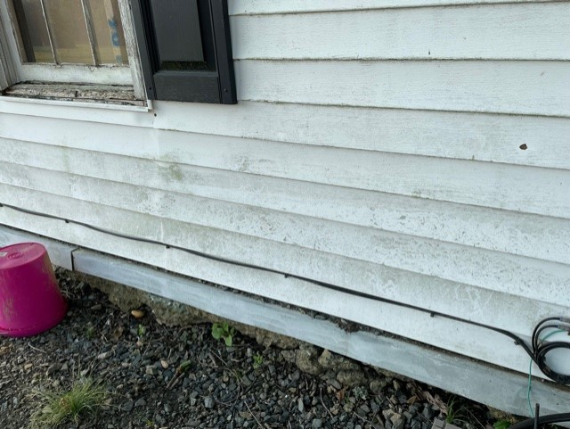
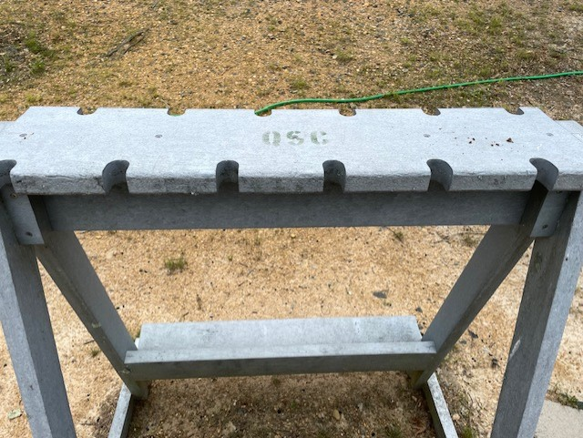
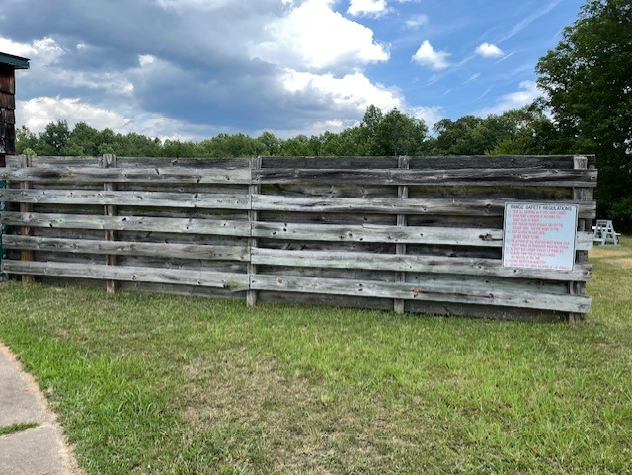
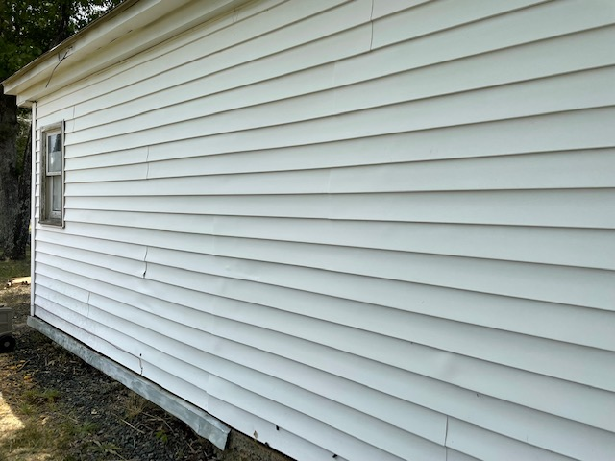
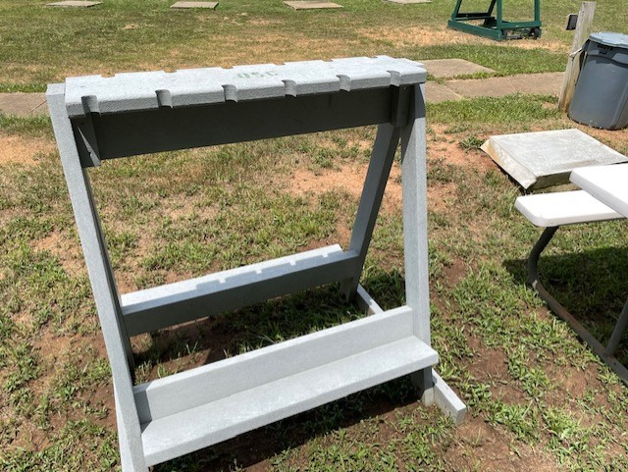
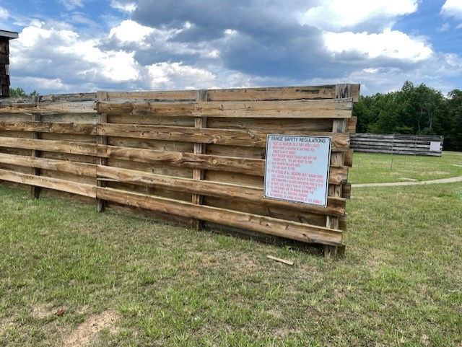
New Business – Operations Report

Slide 15
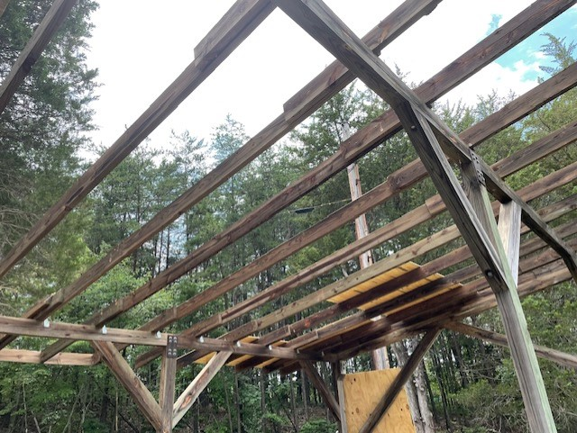
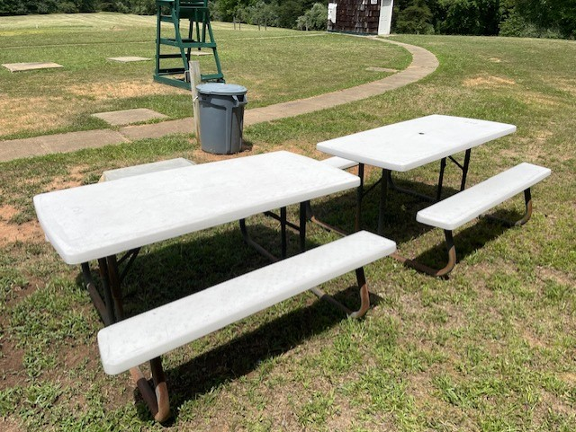
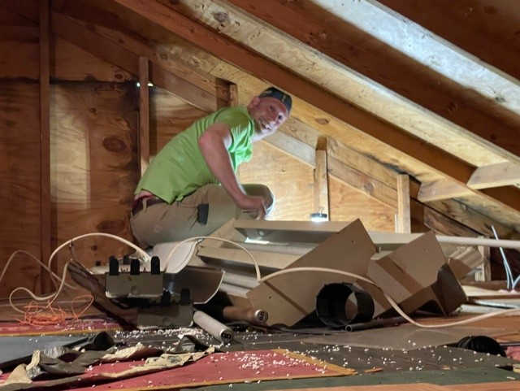
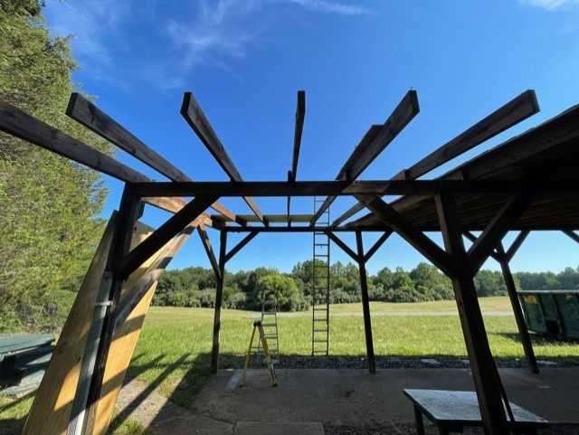
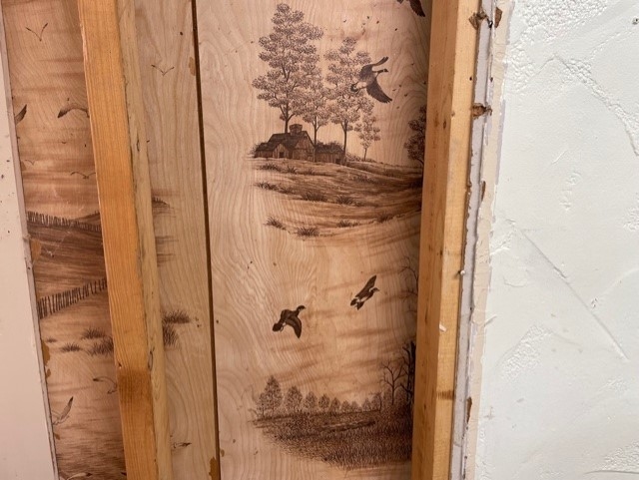
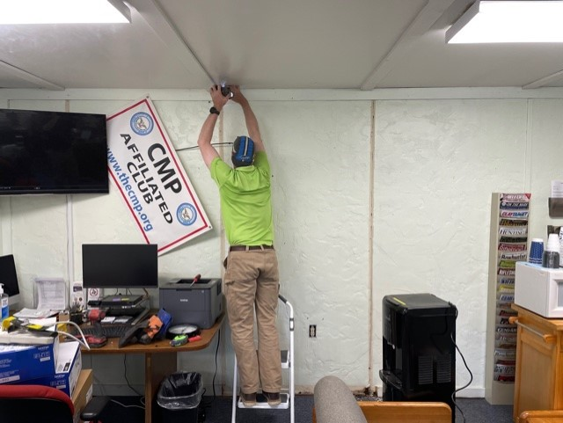
New Business – Operations Report

Slide 16
New Business – Treasurer's Report
QSC Bank Account Balances – Minimum Balances Set at $25K for Each Account for Club Solvency
  However, the Saving Account may be used for large expenses
  Checking:
    1 January 2020 = $18,722.76
    1 July 2020 = $22,091.40
    1 Oct 2020 = $31,267.33
    31 Dec 2020 = $39,750.90
    16 Apr 2021 = $62,806.66
    13 Jun 2021 = $67,938.68
  Savings:
    1 January 2020 = $25,016.13
    1 July 2020 = $25, 022.30
    1 Oct 2020 = $ $25,024.54
    31 Dec 2020 = $25,026.44
    12 Apr 2021 = $25,028.30
    13 Jun 2021 = $25,030.18
    Member deposits (obligations) have been eliminated as of 1 June 2021
7/17/2021
Quantico Shooting Club
15

Slide 17
New Business – Treasurer's Report
As a reminder, the QSC Must Pays:
QSC Must Pays – Membership Cost Calculated at the Rate of $118
QSC Admin – 21hrs week = $19,656 annually = 167 Memberships | QSC EMT = $840 monthly = $10,080 annually = 86 Memberships
QSC Insurance = $4,145 ($3,868) annually = 35 Memberships | QSC Clubhouse Lease = $5,000 = 43 Memberships
QSC Managed Web Services = $250 monthly = $3,000 annually = 25 Mbrs. | QSC Porta-John = $220 monthly = $2,640 annually = 23 Memberships
QSC Phone & Internet = $300 monthly = $3,600 annually = 31 Memberships | QSC Accountant = $417 monthly = $5,000 annually = 42 Memberships
QSC MS Office 365 = $55 monthly = $660 annually = 5 Membership | QSC Quick Books = $40 monthly = $480 annually = 4 Memberships
Payroll Liability= $100 monthly = $1,200 = 10 memberships | QSC Lease Administration = $1,000 annually = 8 Memberships
Facility & Grounds Maintenance = $2,500 = 21 Memberships | Equipment & Repairs = $2,500 annually = 21 Memberships
Verizon Web Ref – EMT Scheduling Website - $188 Annually = 2 Members
Must pays (club required operations) equal $41,993 or 356 Paid Memberships Annually. This is down from the $61,184 / 518 reported in Jan 2021 but up $405 from the last quarter due to an increase in insurance costs driven by higher club membership.

Slide 18
New Business – Secretary’s Report
Membership Report
 | January 2021 | February 2021 | March 2021 | April 2021 | May 2021 | June 2021
Regular Members | 878 (74%) | 852 (73%) | 899 (74%) | 972 (73%) | 976 (74%) | 1035 (74%)
Associate Members | 309 (26%) | 309 (27%) | 318 (26%) | 352 (27%) | 344 (26%) | 359 (26%)
TOTAL MEMBERS | 1187 | 1161 | 1217 | 1324 | 1320 | 1394
  Fairly steady growth since opening post-COVID restrictions – 11 April 2020 Quarterly Report – 610 Members
  Membership ratio is well within the MCBQ directed 2/3 Regular – 1/3 Associate member requirements
  This time last year we had 885 members. Today we have a membership of 1308. Roughly 47.8% growth.

Slide 19
New Business – RSO Report
RSOs are the lifeblood of the Club – Ranges don’t open without our RSOs
There are currently 67 certified RSOs
There are 15 club members with expired RSO certifications
RSO Volunteer Efforts (last 12 months):
  37 RSOs have opened 0-5 ranges
  12 RSOs have opened 6-10 ranges
  15 RSOs have opened 11-15 ranges
  4 RSOs have opened 16-20 ranges
  3 RSOs have opened 21-25 ranges
  3 RSO has opened 26-30 ranges
  2 RSO has opened 31-35 ranges
  2 RSO has opened >35 ranges
There are 3 members currently waiting to attend to MCBQ OIC/RSO In-Person Brief
There are 18 members enrolled in the MarineNet CBT Basic Range Safety Course
Notes:
Limiting factor on range openings is, of course, volunteer RSOs.
Range Management Branch is insistent that the QSC provide a dedicated OIC & RSO on each range. Effectively meaning we need three RSOs per range.

Slide 20
New Business – RSO Report
Range Utilization Report – April – June: 26 Weekend Days Available
  4 days – Range Control Closed (Holiday / No Unit Training) (15%)
  1 day – QSC Closed (Mothers Day) (4%)
  21 days – Ranges Open (81%)
Range Openings:
April-June: 61 Ranges Opened – 1,388 Members and our Guests enjoying shooting sports through the QSC
Recreational Fire:
  Range 1 (Rec Fire) – 6 days
  Range 2/3 (Rec Fire) – 5 days
  Range 4 (Rec Fire) – 9 days
  Range 305 (Rec Fire) – 9 days
  SAT Range (Rec Fire) – 3 days
  Shotgun (Rec Fire) – 12 days
Match Events:
  Range 1 (.22 PRS Match) – 2 days
  Range 3 (GSM / XTC / EIC Match) – 5 day
  Range 4 (PRS / Rifle Matches) – 3 days
  SAT Range (USPSA / SC Matches) – 7 days
  Shotgun (Matches) – 0 days
Notes:
77 weekend days available from January to September.
Ranges closed 30 days (28 outside our control) or 39% of the available time
Ranges opened 47 days or 61% of the available time
Board goal to have a General Purpose Range (like Range 1 or Range 305) open every weekend and we were very close to achieving that with a GP Range open 29 days
Other numbers speak for themselves

Slide 21
New Business – Match Report
The club conducted 24 matches in 2020 – To date in 2021 QSC has held 15 matches and cancelled 4 events
  USPSA – 3 Matches
  Steel Challenge – 3 Matches
  PRS Centerfire – 2 Matches
  PRS Rimfire – 3 Matches
  NSSA – 1 Match, 3 Cancelled
  Trap – 1 Match Cancelled
  GSM – 2 Matches
  Vintage Precision – 1 Match
Revenue from each match reinvested in improving that specific shooting discipline, as well as supporting other discipline’s needs or infrastructure upgrades
Goal is to have each shooting discipline self-sustaining
Focus now on getting ATA and NSSA-NSCA shotgun matches started again
Notes:
Club has conducted 19 matches to date
USPSA and Steel Challenge are self-sustaining and part of their profits are covering expenses in other areas.
Objective is to have each shooting discipline cover their own expenses and to permit infrastructure sustainment and improvement where possible.
We cancelled our Trap and Skeet matches this year and with the clubs focus on improving the fields and throwers we hope to get matches up and running this spring.
Any questions?
Tim?
Shawn / Jim?
Jim Otto / Rich?
Matt?
Range 4 conducts its own match called the Milk Jug Challenge. Skip did you want to add anything at this point in the meeting?

Slide 22
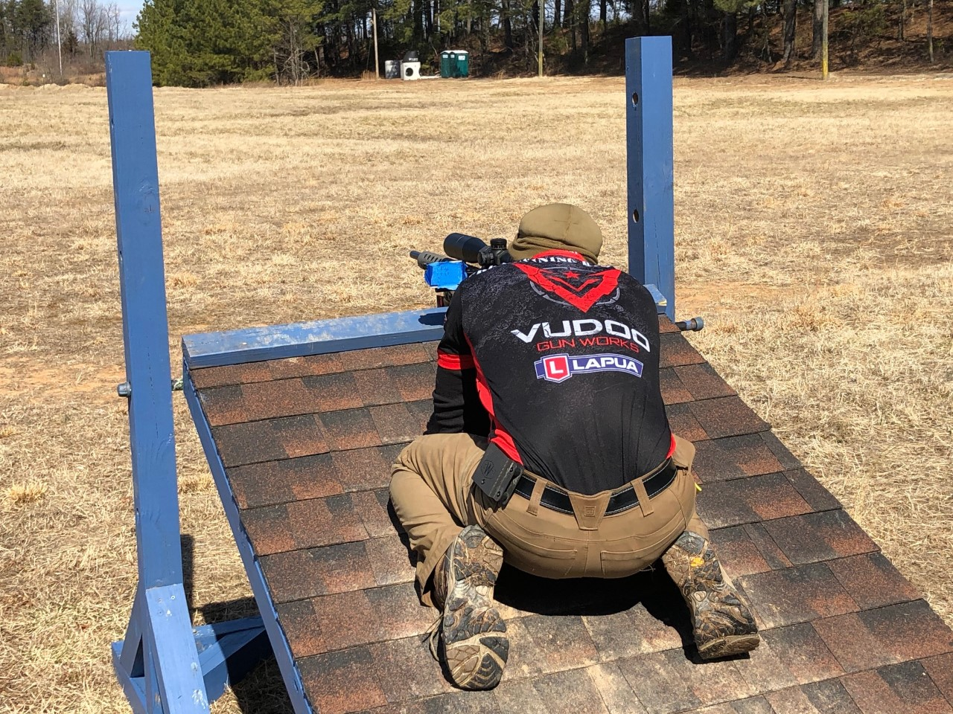
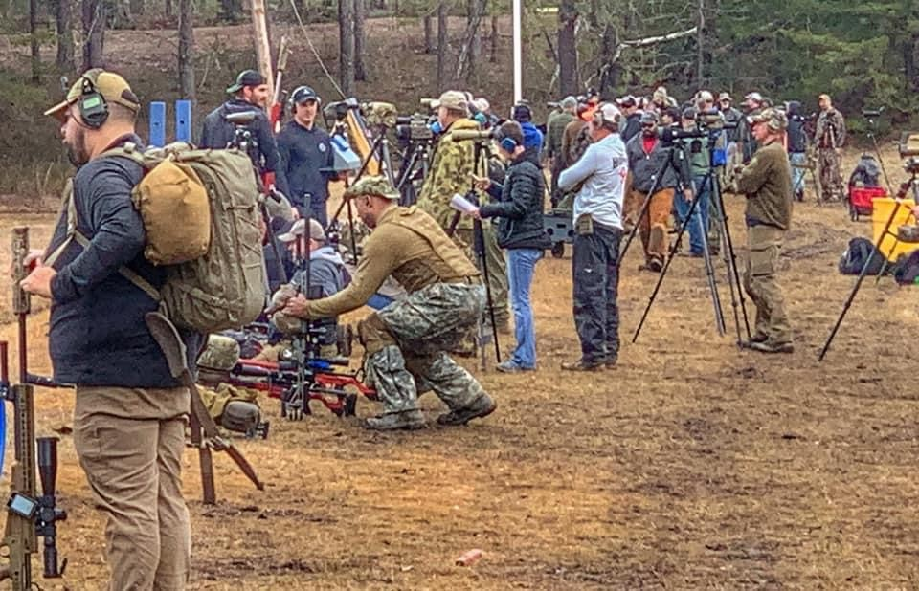
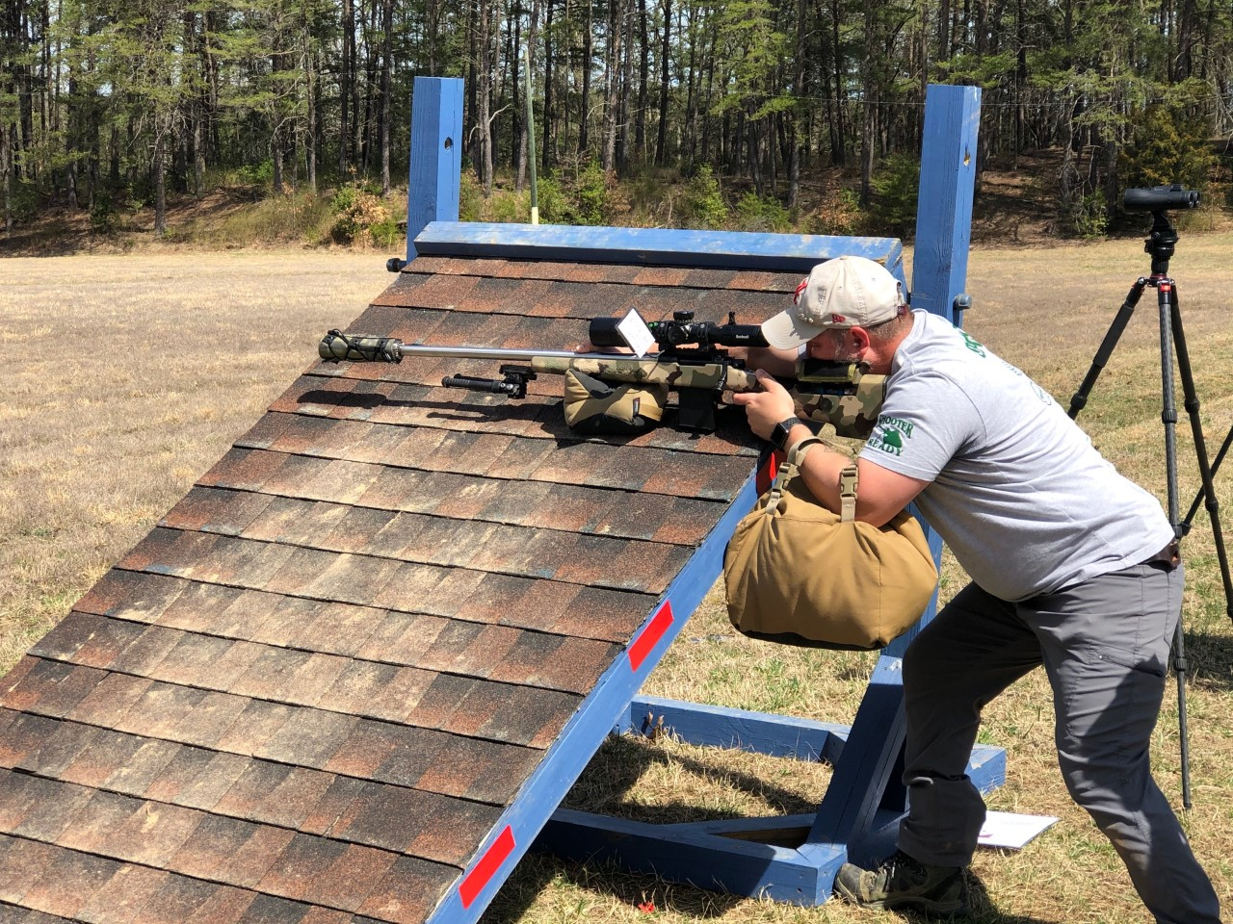
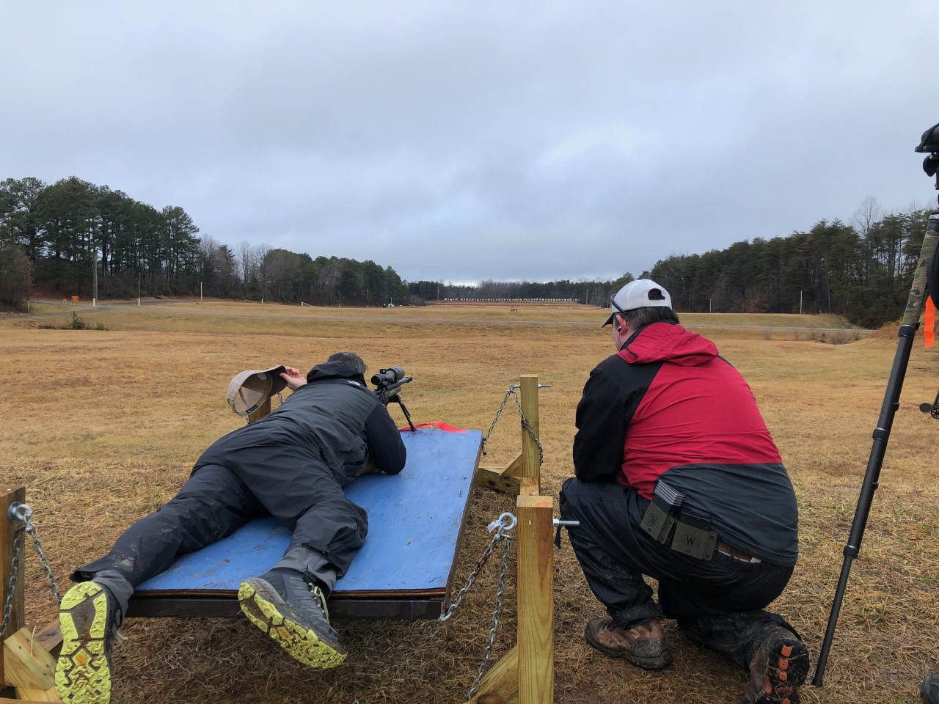
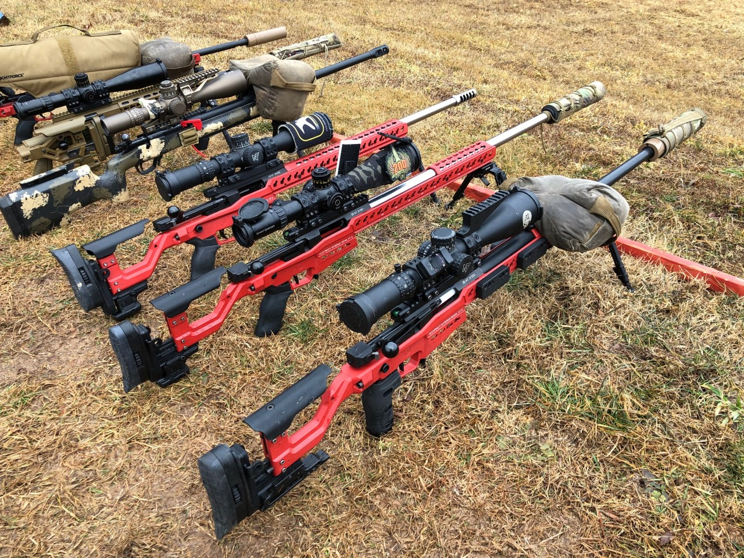
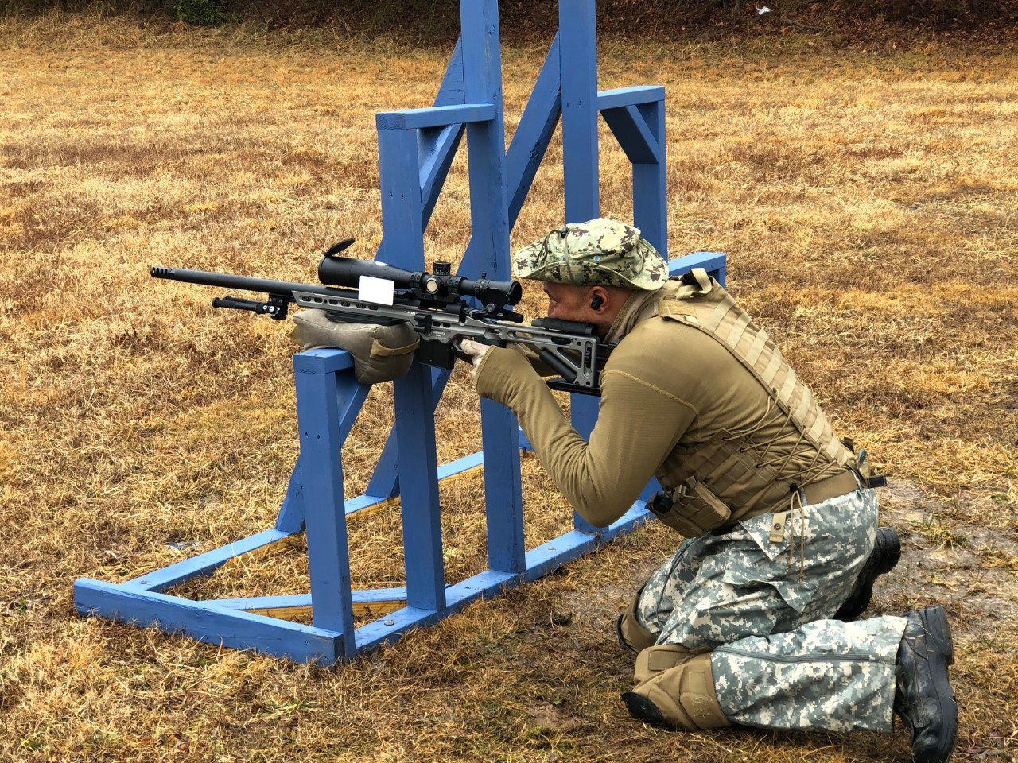
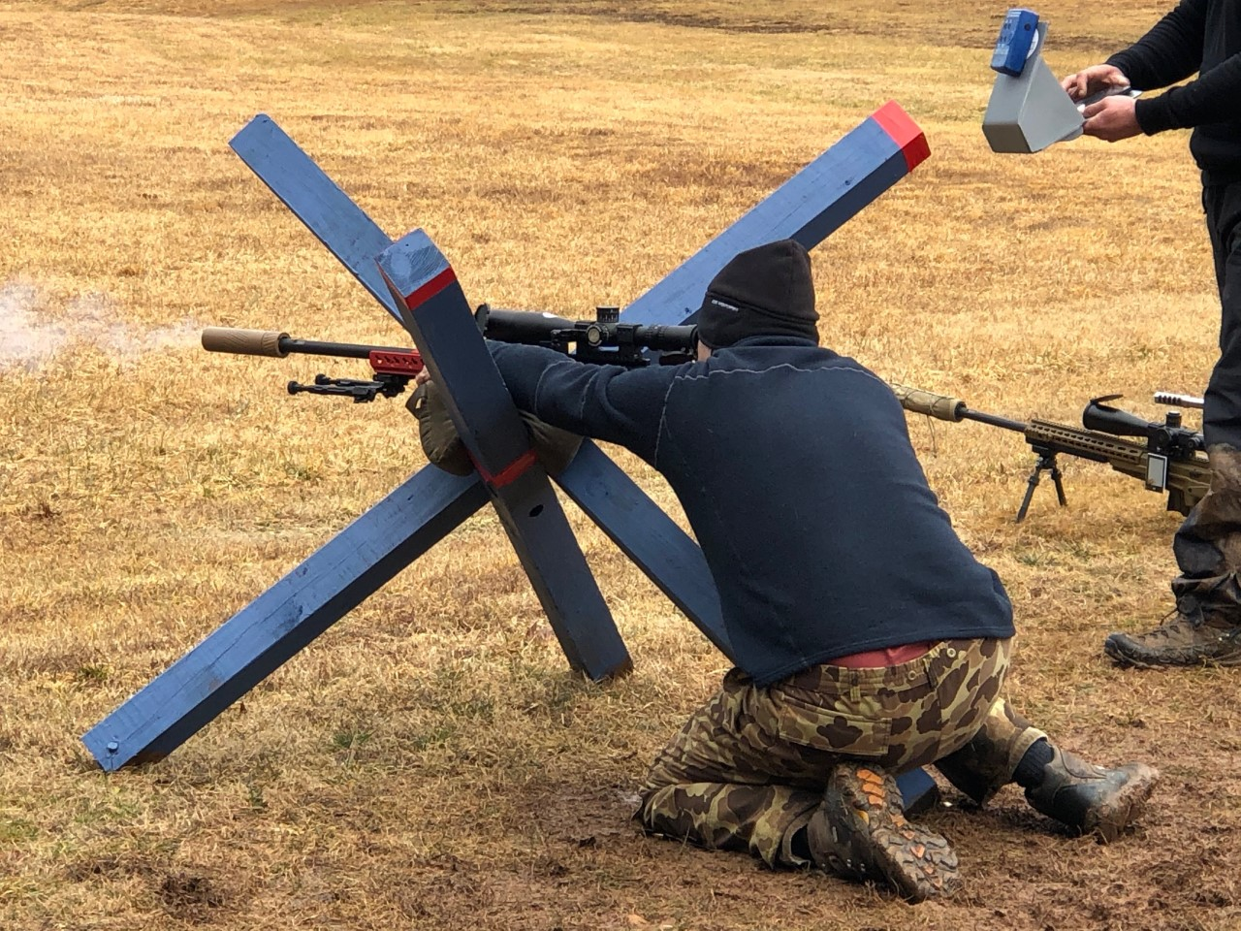
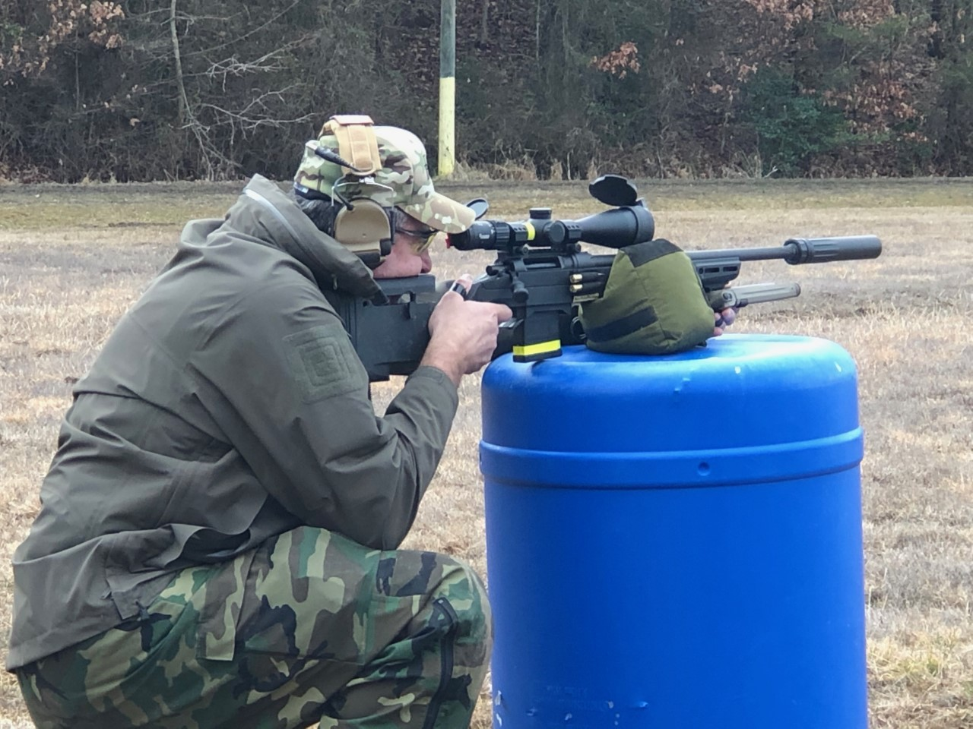
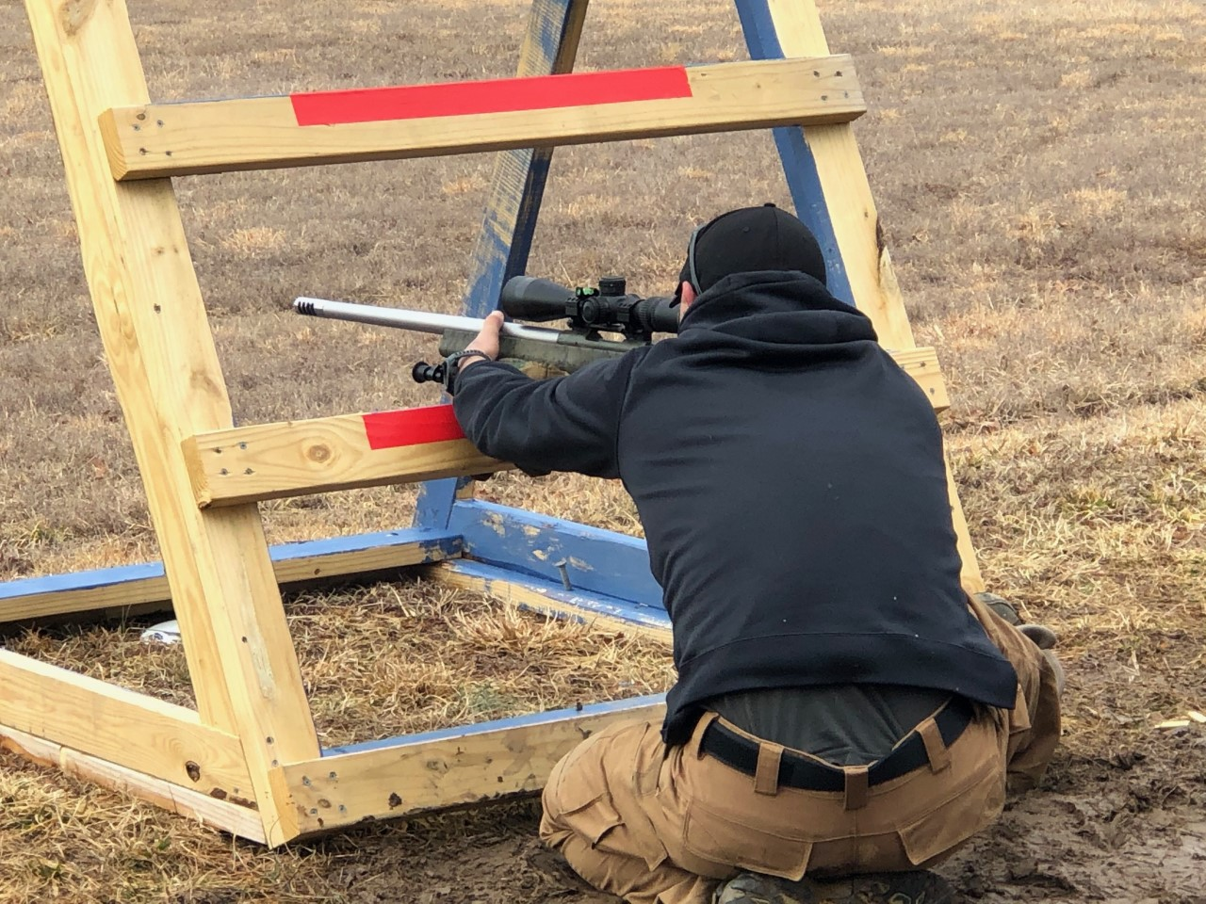
New Business – Match Report
  USPSA & Steel Challenge – Huge 2020 marketing successes for QSC – Very positive on-line comments
  PRS Centerfire / Rimfire – Equally impressive in 1st QTR 2021 while increasing QSC name recognition – Massive local audience
    Participation has steadily increased in these matches – Word is getting out about QSC – Professional leadership and investments
    The exception is shotgun – efforts have not produced results and the MD is departing for USAF Flight School – no replacement identified
7/17/2021
Quantico Shooting Club
21

Slide 23
New Business – Match Director Comments
USPSA – Tim Hichak
Steel Challenge – Kevin Shannon
PRS Centerfire – Tim Hichak
PRS Rimfire – Ken Freeman
Vintage Precision – Jim Otto
GSM – Rich Martinez
Shotgun – ?????????
Notes:
The club continues to receive very positive comments regarding the professionalism and consistency of our marksmanship matches.
Attributable to the amount of effort from our volunteer match directors
Tim Hichak, Zach Basich – USPSA
Shawn Pratt, Jim Wisniewski – Steel Challenge
Jim Morgan, Jim Otto, Rich Martinez – Vintage Precision Rifle
Matt Gundlach - MultiGun

Slide 24
New Business – Member Discussions
New Business
  Board Vacancies
Member Discussions
  Open Forum
7/17/2021
Quantico Shooting Club
23

Slide 25
FINAL DISCUSSIONS
ANY SAVED ROUNDS?
7/17/2021
Quantico Shooting Club
24

