Slide 1

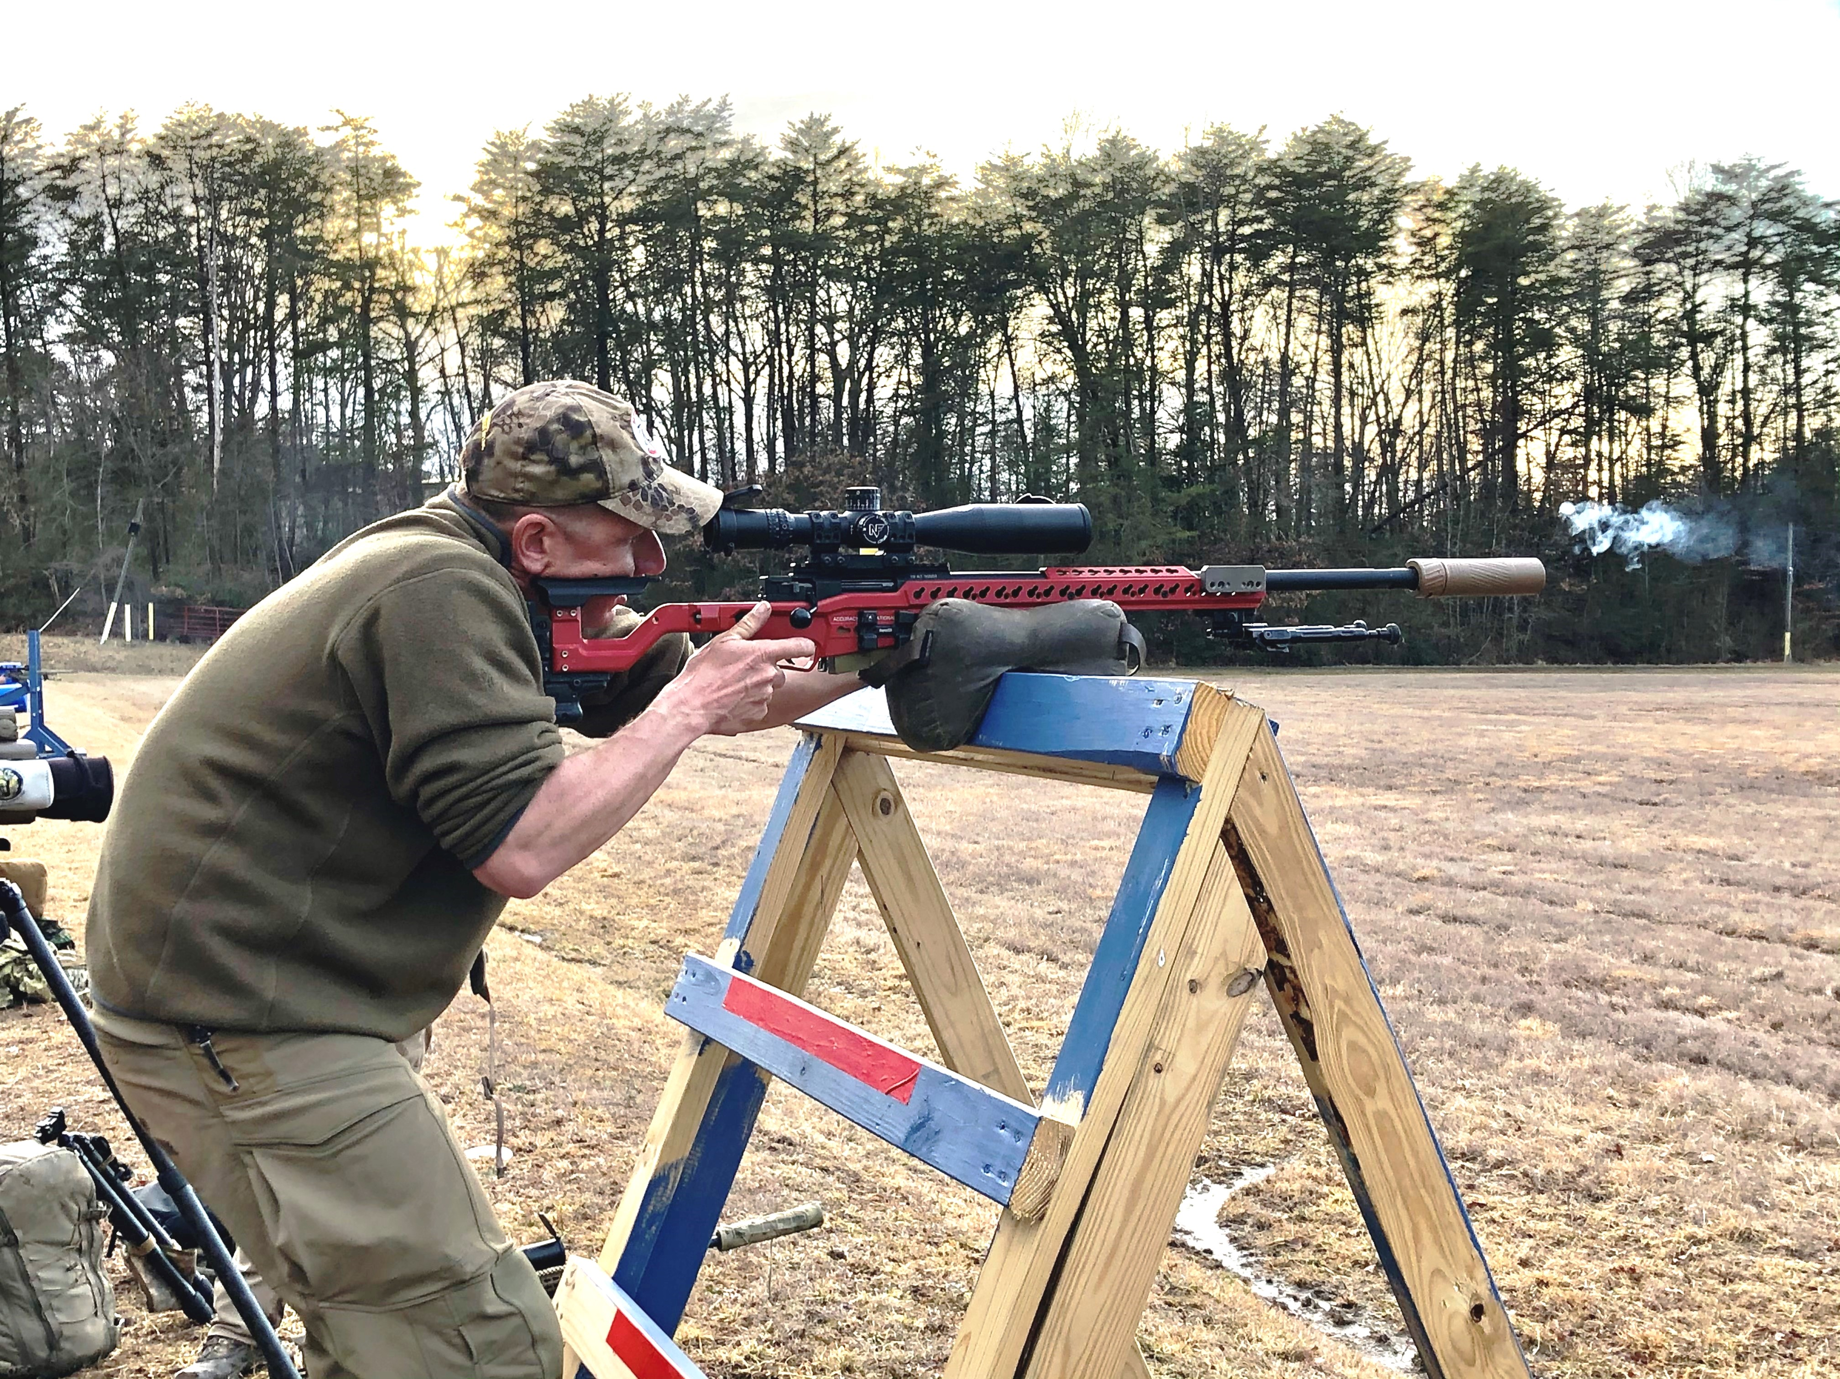
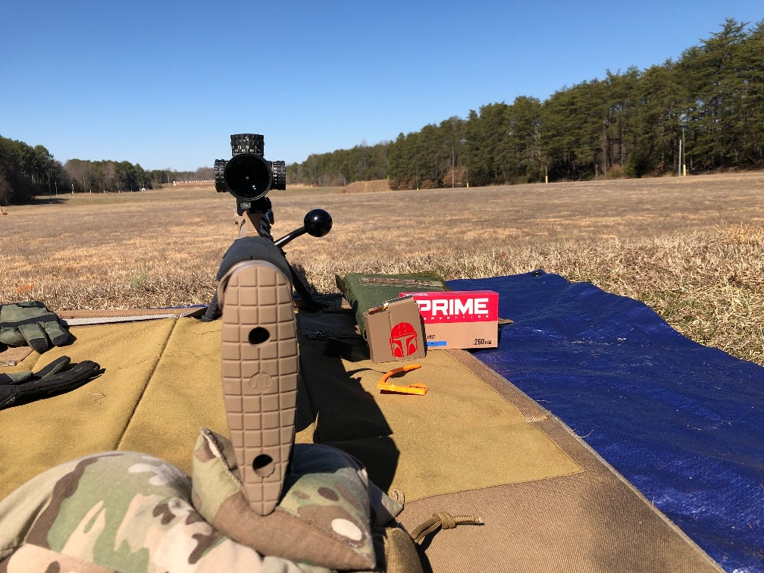
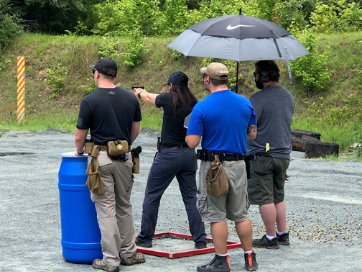
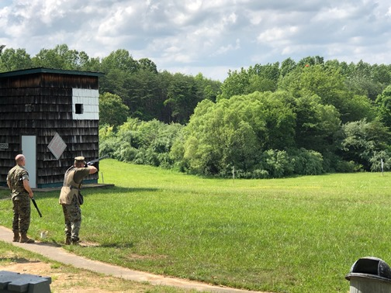
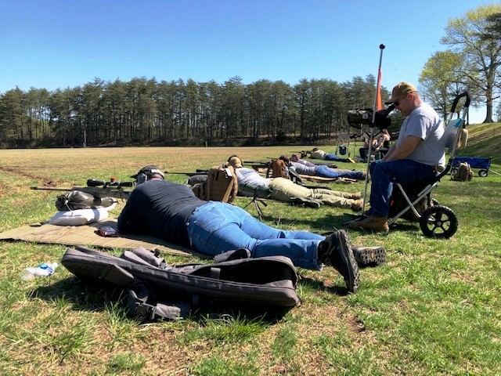
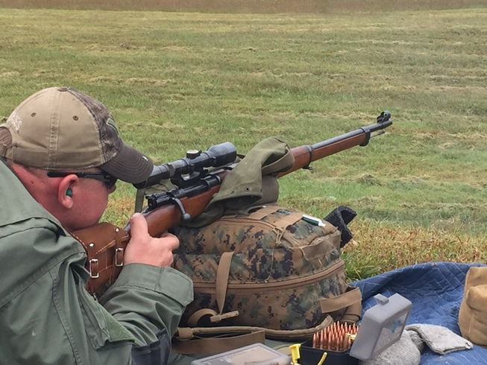
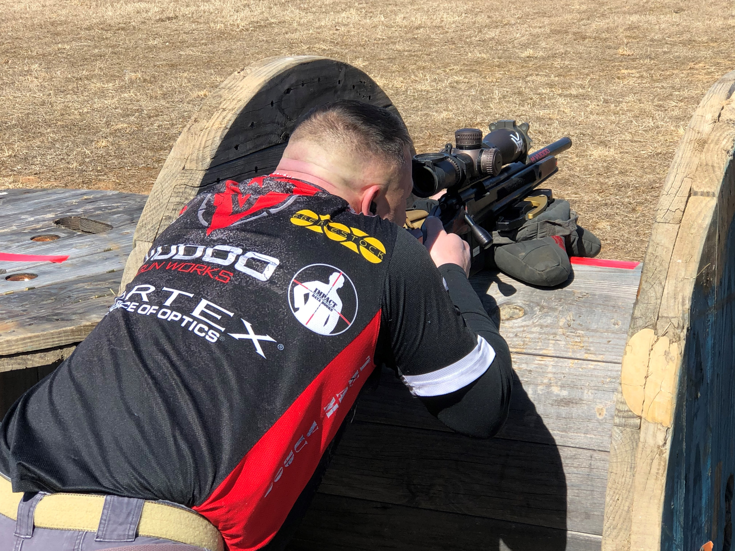
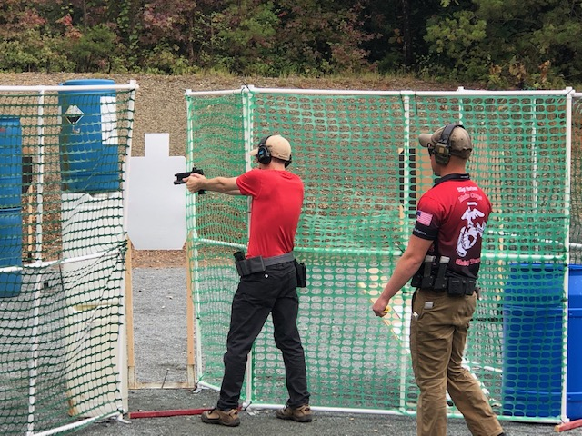
Quantico Shooting Club 3rd Quarter 2021 Member Meeting
10/16/2021
Quantico Shooting Club

Slide 2
QSC 3rd Quarter Member Meeting Agenda – Oct 16, 2021
Welcome
Special Presentations
Old Business
  Acceptance of previous Meeting Minutes
  Ongoing & BoD Activities
New Business
  BoD Activities
  Operations Report
  Treasurer’s Report
  Secretary’s Report
  RSO Report
  Match Report
  Match Director Comments
  Open Forum
10/16/2021
Quantico Shooting Club
1

Slide 3
Special Presentation
QSC’s success is due to our many members who serve as RSOs, assist with the recurring and unique work parties, provide their expertise, serve as range directors, etc., etc.
We’d like to recognize an RSO who has stepped up from our many volunteers with a small token of our appreciation for their dedication and leadership:
  Kevin “Kabooch” Roth – RSO who has volunteered time on every QSC range, as well as time for the Friday WTBN recreational shoots

Slide 4
Old Business – Secretary
Reading of the previous Minutes
Acceptance of previous meeting’s minutes
10/16/2021
Quantico Shooting Club
3

Slide 5
Old Business – Ongoing Activities
Some of the projects we continue to work or assess:
SAMPLE OF ONGOING BOARD PROJECTS
Ongoing – Asset Inventory – Requires total update - 2021 | Ongoing – Implement / Approve longer QSC Officer Terms | Ongoing – Updating Bylaws
Ongoing – Analyze renewals to determine why members depart | Ongoing – Simplify - Too many touch points and manual processes | Ongoing – Establish Match Chairs and provide $1,500 budget
Ongoing – Drafting updated RSO Training

Slide 6
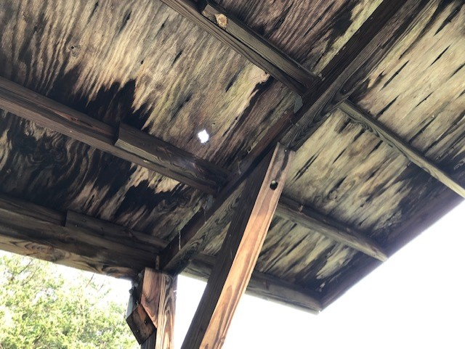
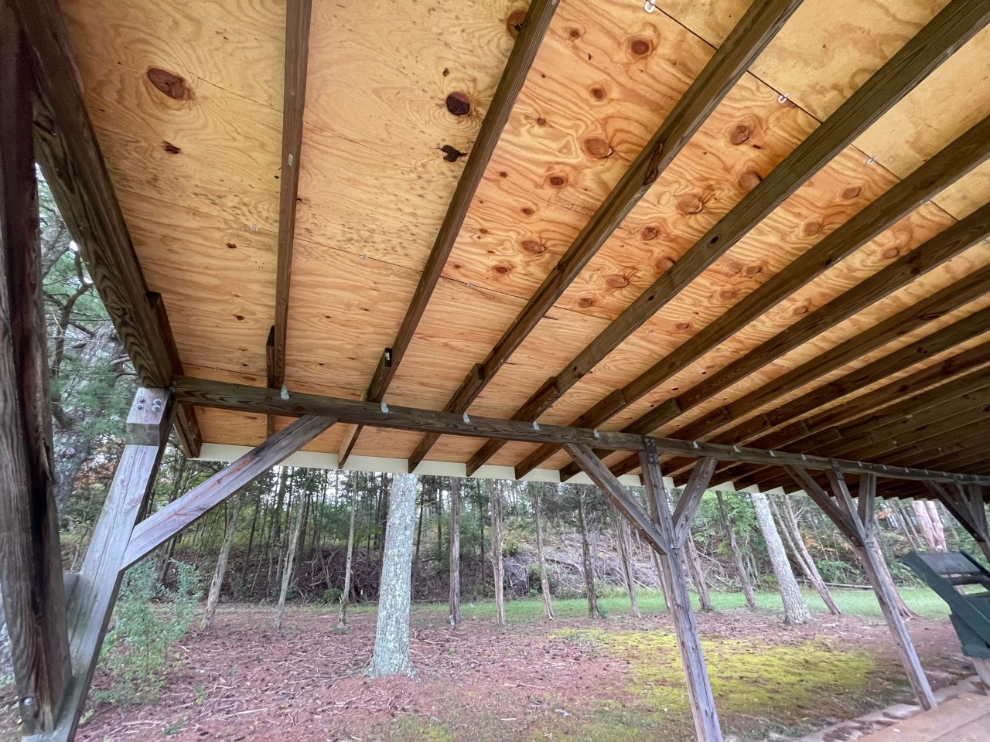
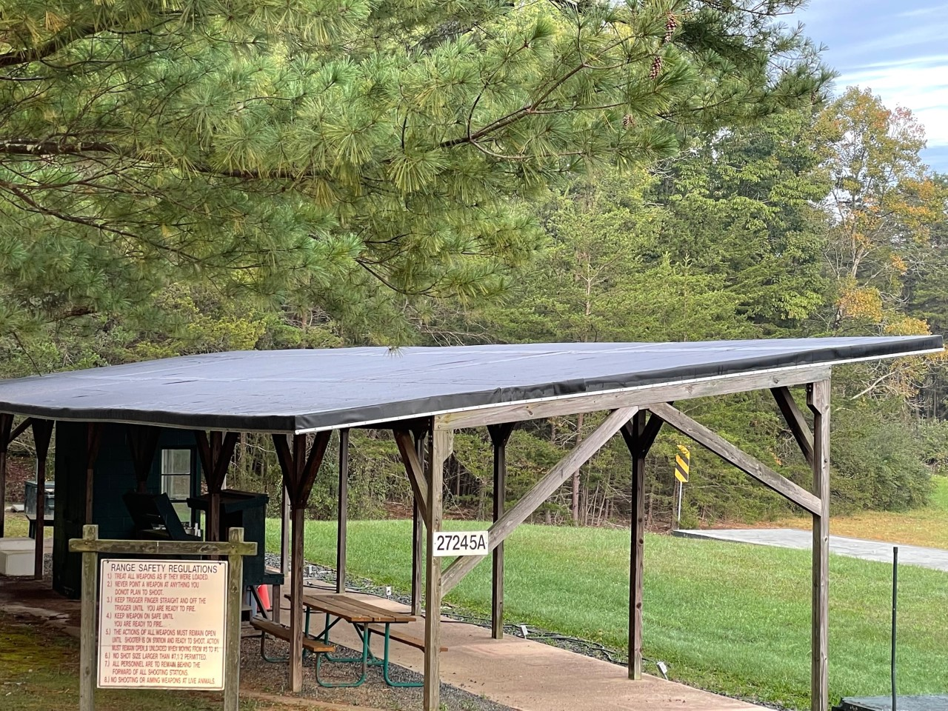
Old Business – International Bunker
Pavilion's roof structure in desperate need of repair
  Supporting structure solid but roof is original and water intrusion has rotted sheathing and facias
UPDATE – Roof repair is COMPLETE

Slide 7
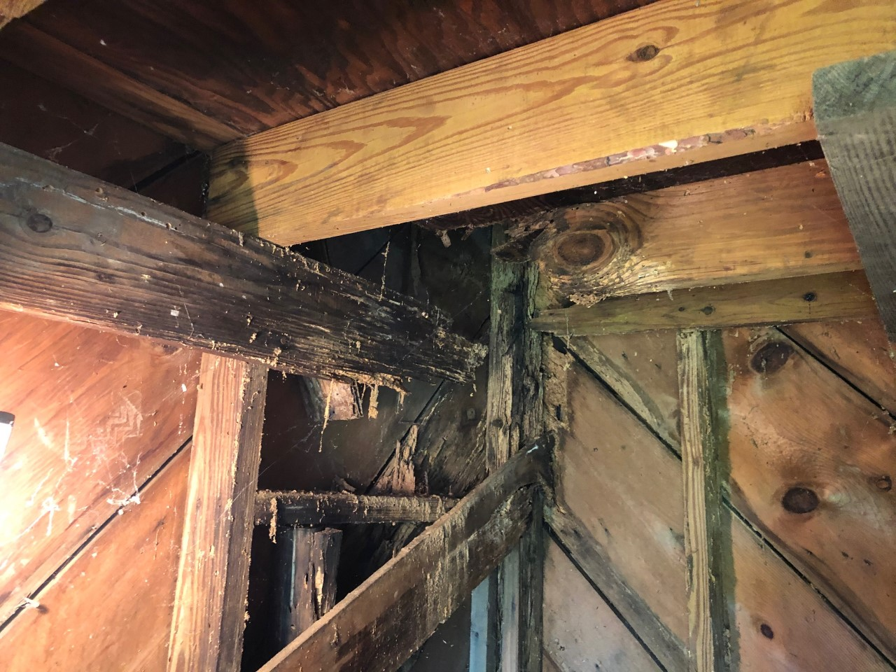
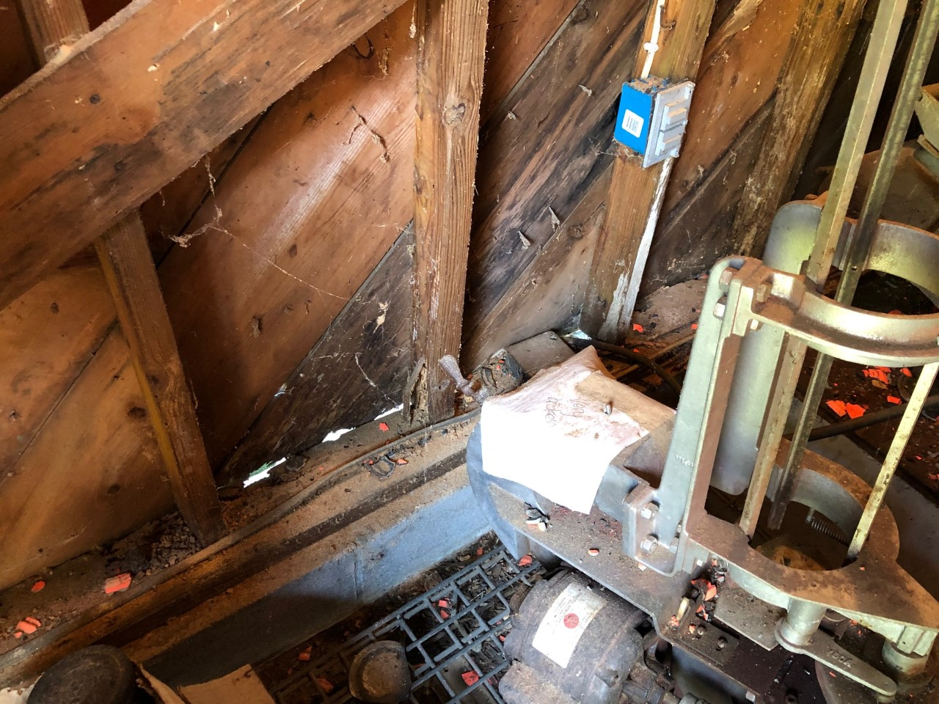
Old Business – Skeet House 4
Corner support and 2nd floor’s joists eaten by termites – also has water intrusion
MCBQ facilities surveyed the house – QSC emphatic, don’t condemn house
  Facilities highly suggested self-help
UPDATE – House may be condemned and torn down unless we commit substantial funds to rebuild – Repair estimate up to $9,500 – will initiate repairs fall 2021

Slide 8
Old Business – Operations & Board Activities
Some of the completed activities for the year:
OLD BUSINESS OPERATIONS & BOARD PROJECTS
Int. Bunker Controller back to DueMatic - LCD Display Bad – Under Warranty | Reinvested ~ 50% of match revenue in USPSA, SC, PRS Rimfire / Centerfire | Bi-weekly Recreational Shoot for WTBN
Continued legacy matches & added more rifle matches to the calendar | Began dissimilar targeting on R4 on 1,000y days when possible | Began a video project to develop a social media friendly QSC video
Began a Website project to update the site to a friendlier format | Began planning the refurb of the clubhouse | Began a search for a membership management software solution - OBE
Purchased a mini-split HVAC system for the clubhouse to replace the window A/C unit ($1,400) - COMPLETE | Assessed the Shotgun Field Barrier Fences – Power washed - COMPLETE | Completed the last of the IT upgrades for the clubhouse with new printers and UPS systems - COMPLETE
Authorized $2,000 to fix the CiviCRM database - COMPLETE | Power washed outdoor items: Picnic tables, shotgun racks, etc. - COMPLETE | Power washed the clubhouse exterior to remove mold/grime - COMPLETE
Ordered and received new RSO T-Shirts - COMPETE | Ran 3 new 20Amp electrical lines in the clubhouse to lessen loads - COMPLETE | Received Insurance Renewal & Annual MCBQ Recert to Operate - COMPLETE
Purchased additional canopies for USPSA and SC - COMPLETE | Purchased 4 canopies for Shotgun - COMPLETE | Ordered new shotgun Pickles, cords and spares for the pickles - COMPLETE
10/16/2021
Quantico Shooting Club
7

Slide 9
Old Business – Operations & Board Activities
Con’t:
OLD BUSINESS OPERATIONS & BOARD PROJECTS
Cleaned / rearranged the shotgun trailer and bought a new clay cart - COMPLETE | Scheduled water line replacement for the clubhouse – COMPLETE | Working no cost repairs to the skeet houses – DOA
Scheduled roof repairs for the Int. Bunker – COMPLETE | Began a replacement project for the many picnic tables – COMPLETE
The Audit Committee positions have been filled and they will begin the process in July – Audit nearly completed

Slide 10
Old Business
Any additional Old Business?

Slide 11
New Business – Board Activities
Some of the Board’s activities the past quarter:
SAMPLE OF ONGOING BOARD PROJECTS
Installed a mini-split HVAC /Heat Pump to replace the window A/C – also adds heating for winter | Stained the shotgun retention fences to prevent further UV and weather damage / deterioration | Removed six oak trees from the property – dead for years and dropping limbs creating a hazard
Initiated an RSO Certification Course to meet USMC/MCBQ requirements – Held five courses since August | Fixed the club’s website, the back end CIVI-CRM database and back paid the vendor - $7,500 | Installed EzPull wireless controllers on Fields 1 & 2 – Eliminates non-payment losses of about $2,000 annually
Replaced 60-year-old club windows with six new vinyl windows - $4,500 | Asphalt sealed the roofs of three storage Conex’s, 2 of which were leaking | Initiated a reclamation project by the shotgun trailer to limit erosion
Initiated a work order to replace the exterior Green House door | Bought a new Zero-Turn 60” mower to supplement the JD Tractor - $6450 | Bunker Controller back to DueMatic - LCD Display Bad – Returned INOP
Removed unused poles and stands from shotgun to speed mowing of fields | Purchased a T-Post Driver and Hammer Drills for USPSA / Steel Challenge - $750 | Received a 20’ TEU storage Conex for PRS matches – Placed by Range 4
Scheduled a KD frame work party to rehab frames used in matches and at R4 | Cleaned and edged the four shotgun field walkways | Approved a wireless EzPull system for American Trap - $1,500
Painted the road barriers along the international drive for safety | Changed the brakes on the skeet field 1 machines and recalibrated the throwers | Cleaned Green Conex and arranged for tool storage – Sealed for rodent control
10/16/2021
Quantico Shooting Club
10

Slide 12
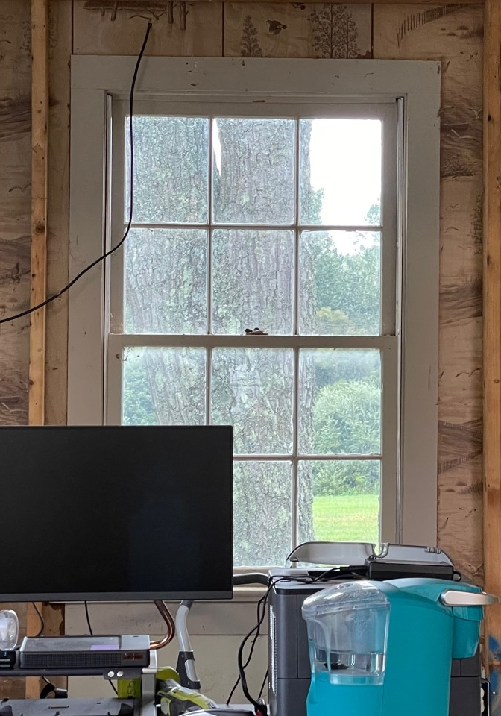
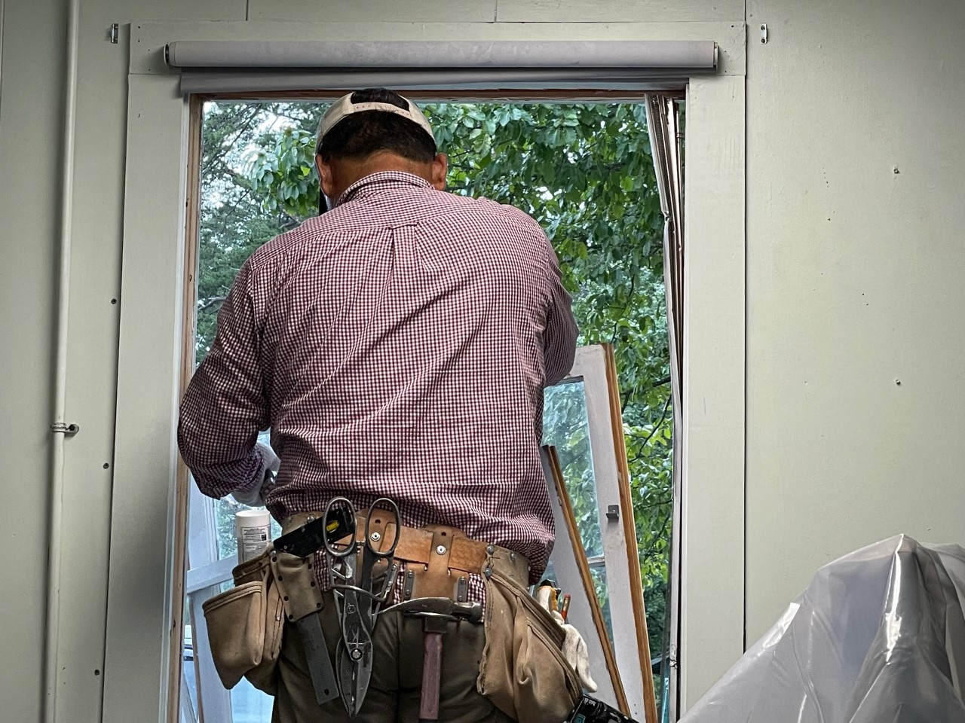
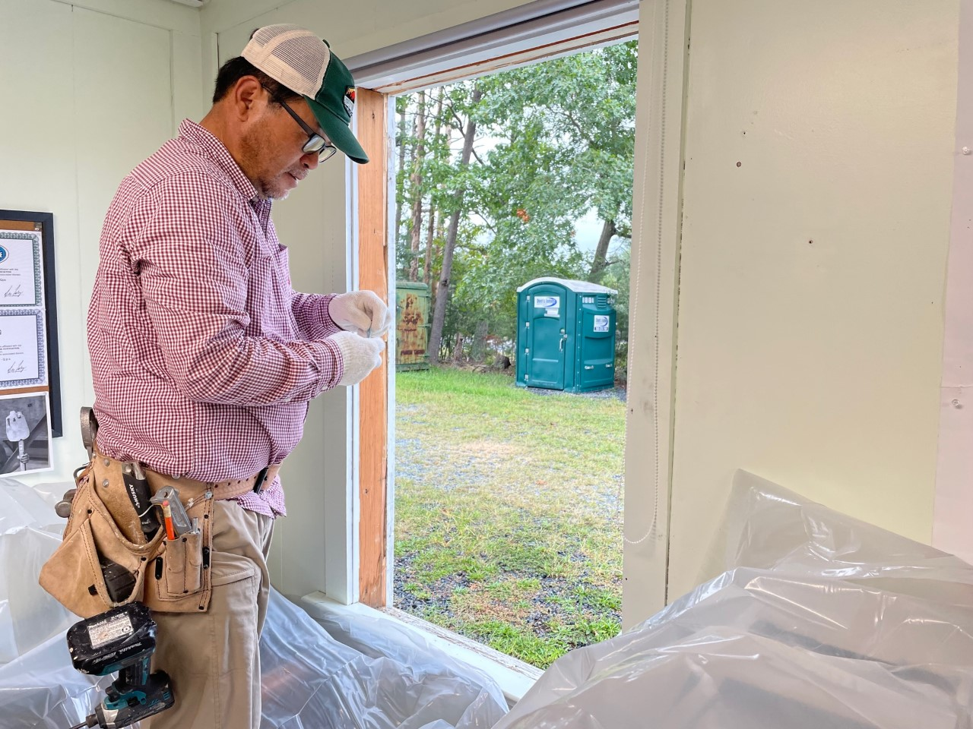
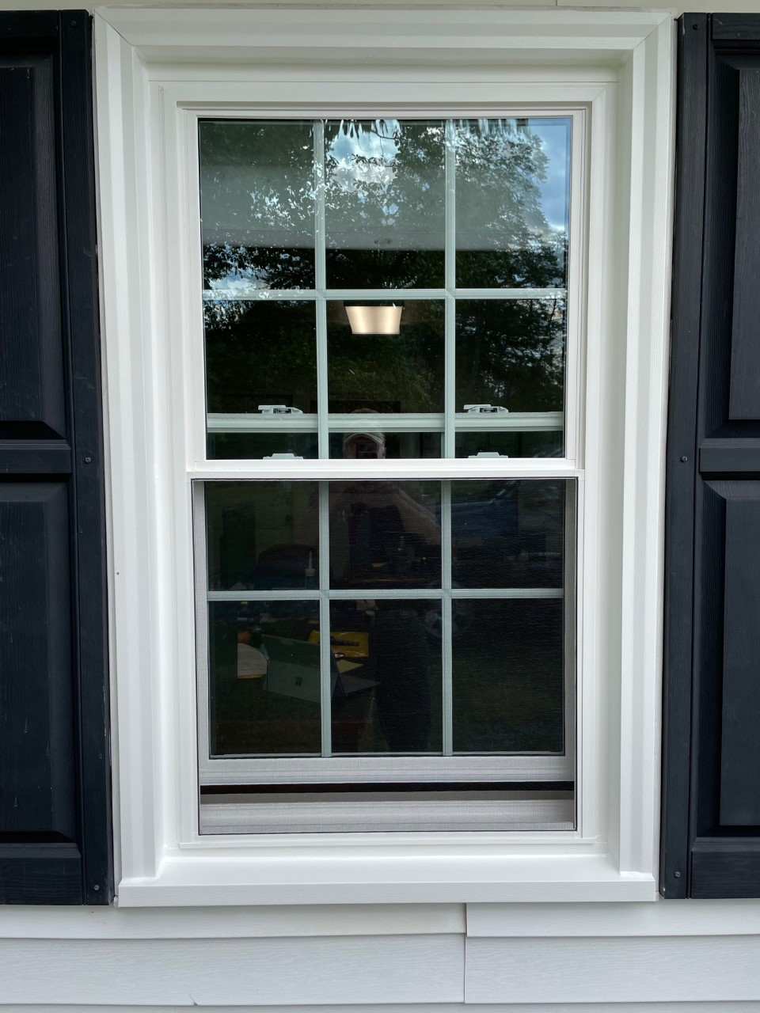
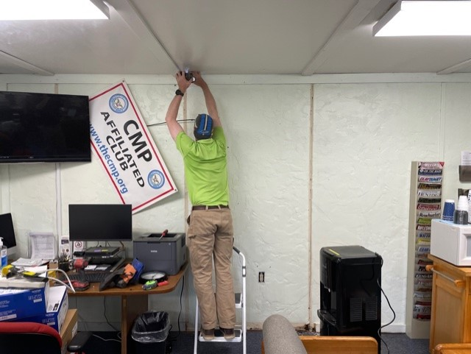
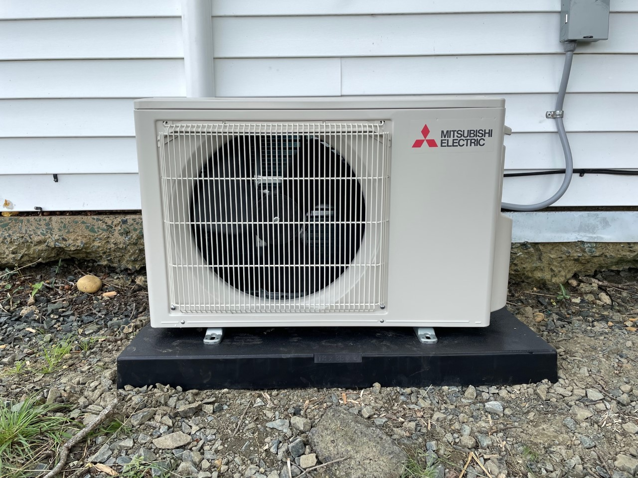
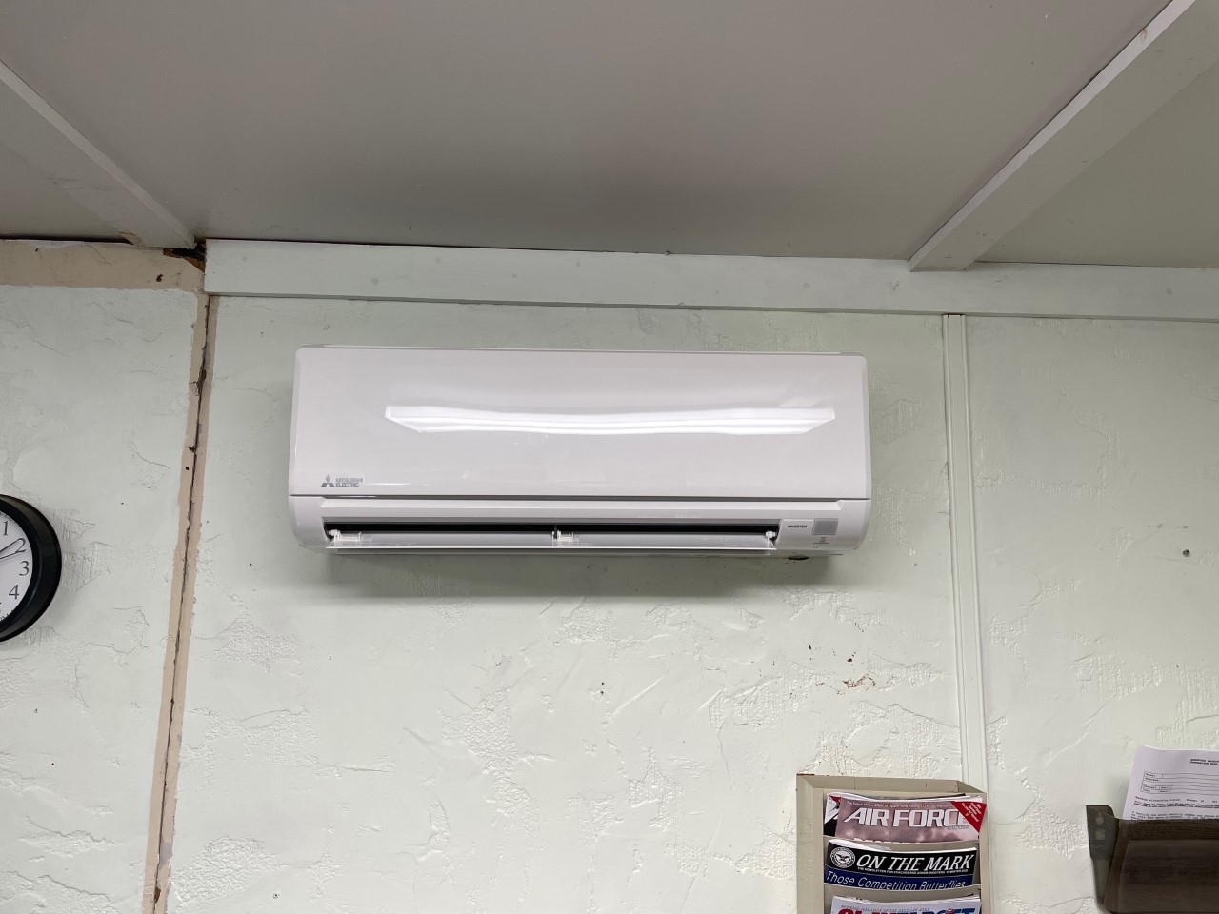
New Business – Board Projects

Slide 13
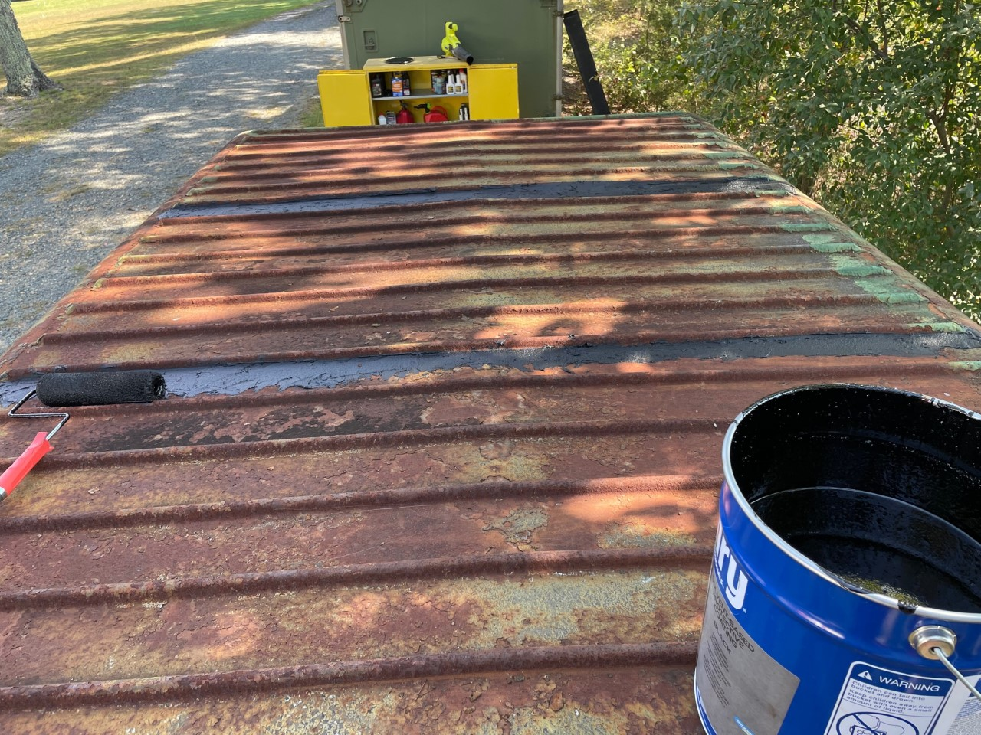
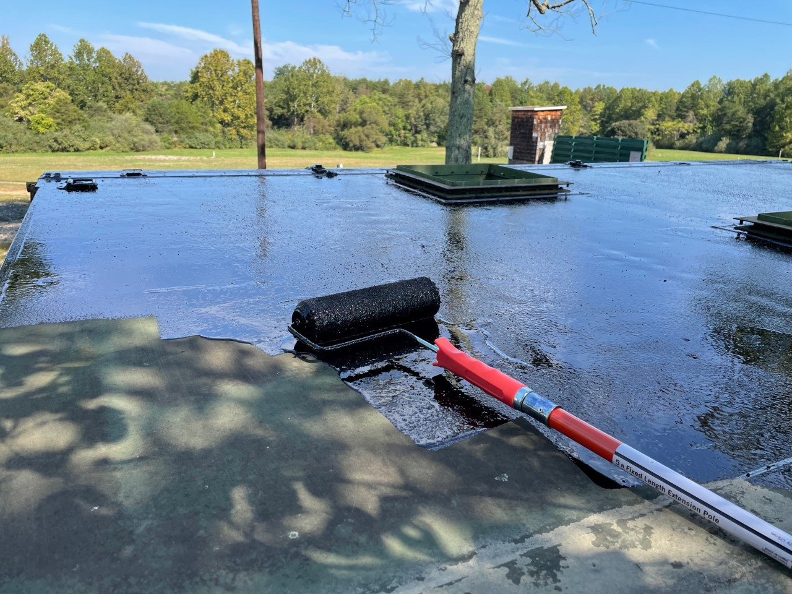
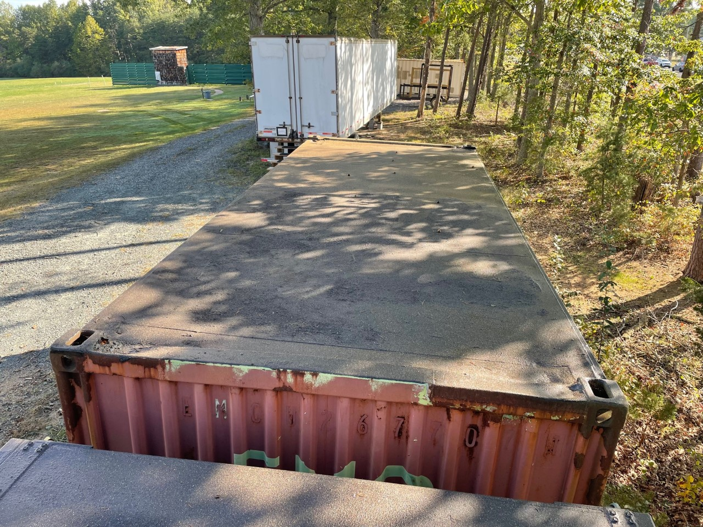
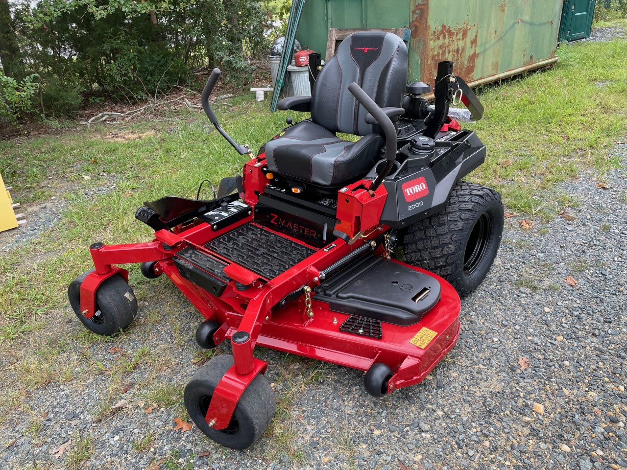
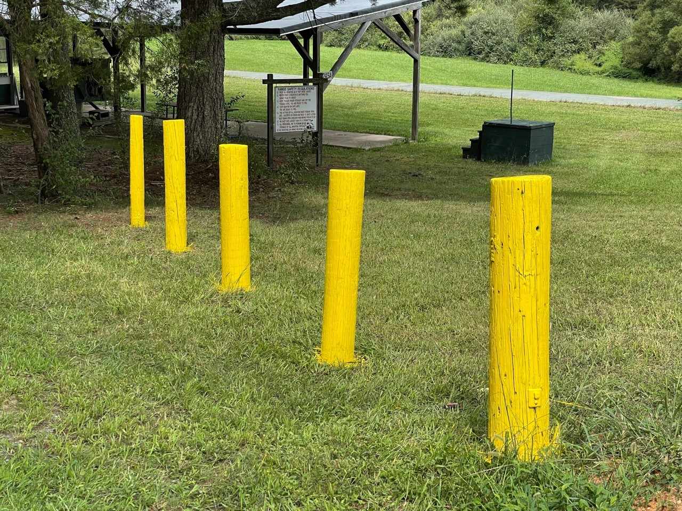
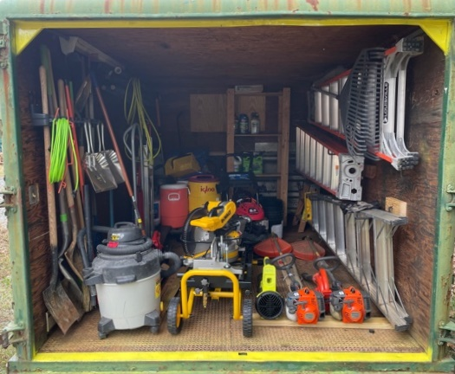
New Business – Board Projects

Slide 14
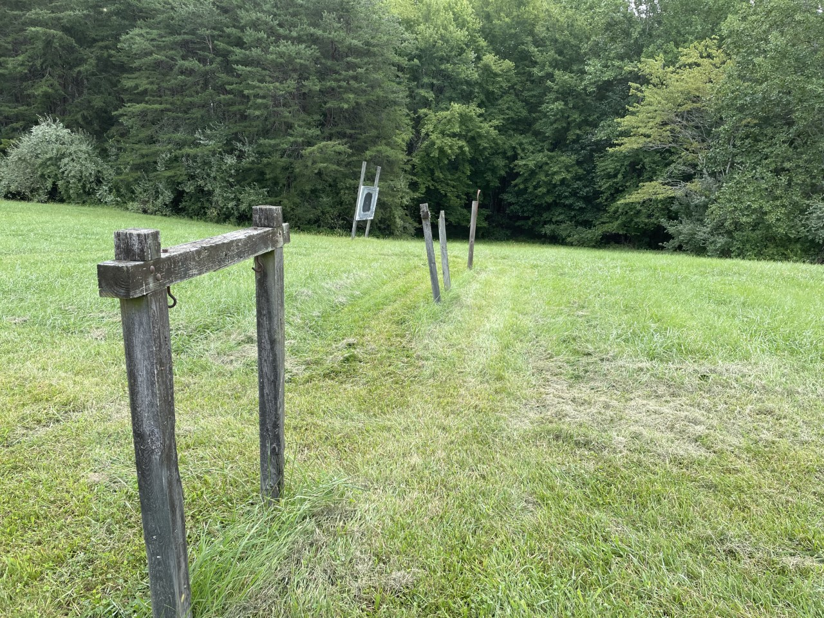
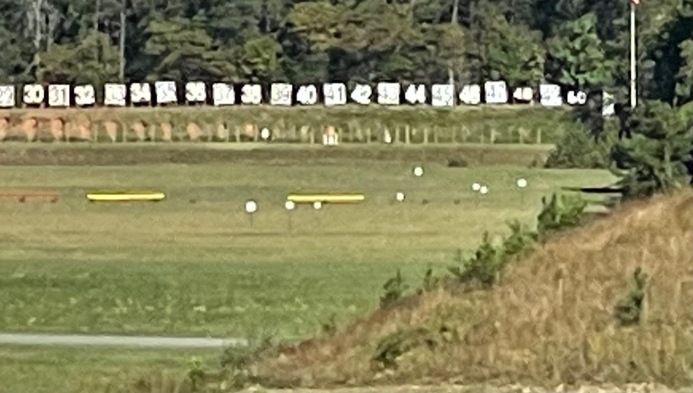
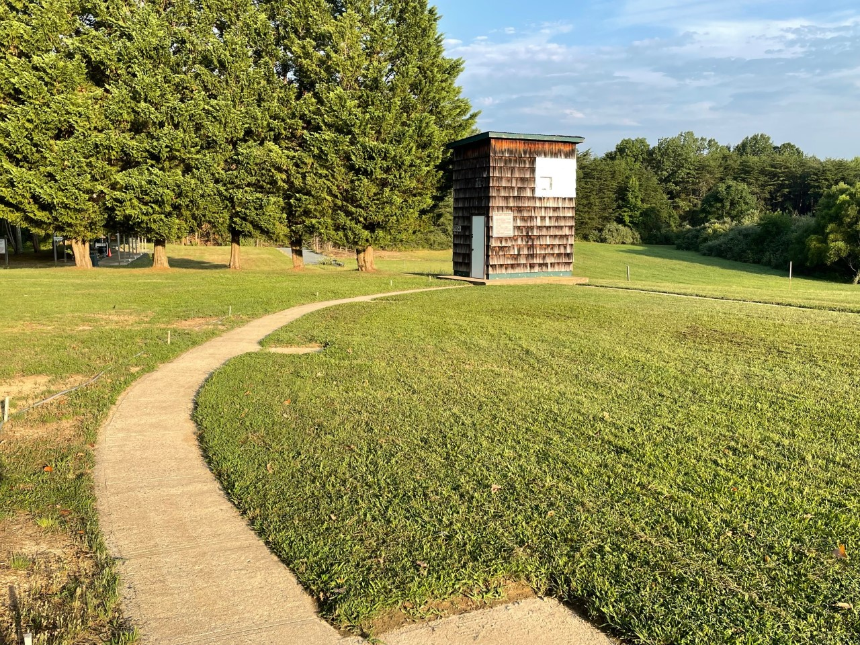
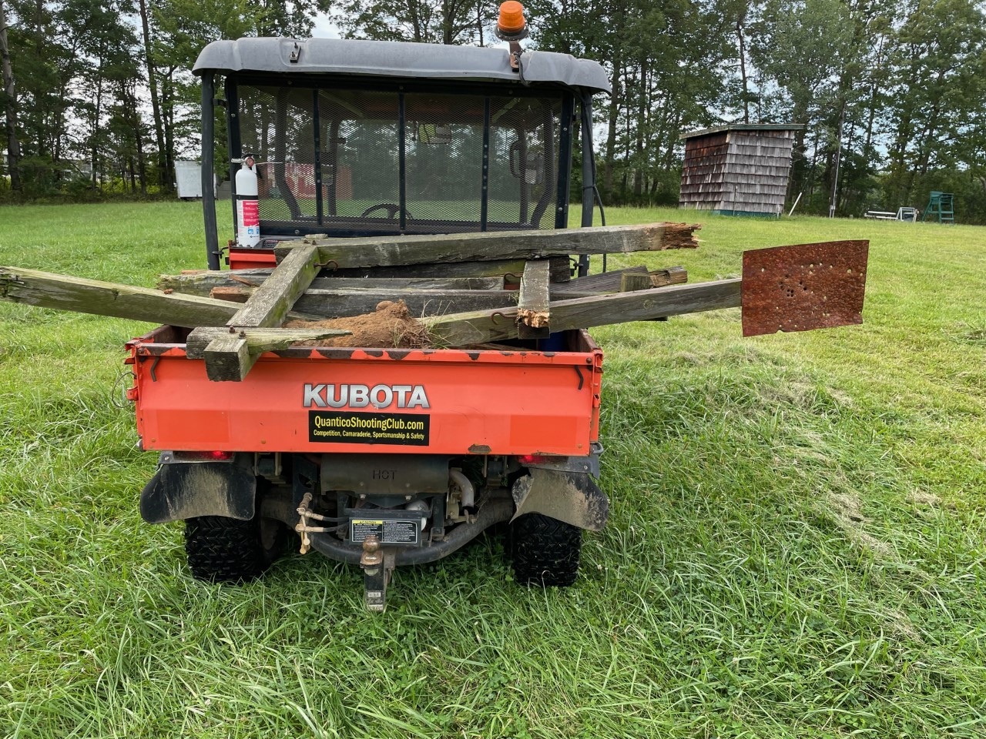
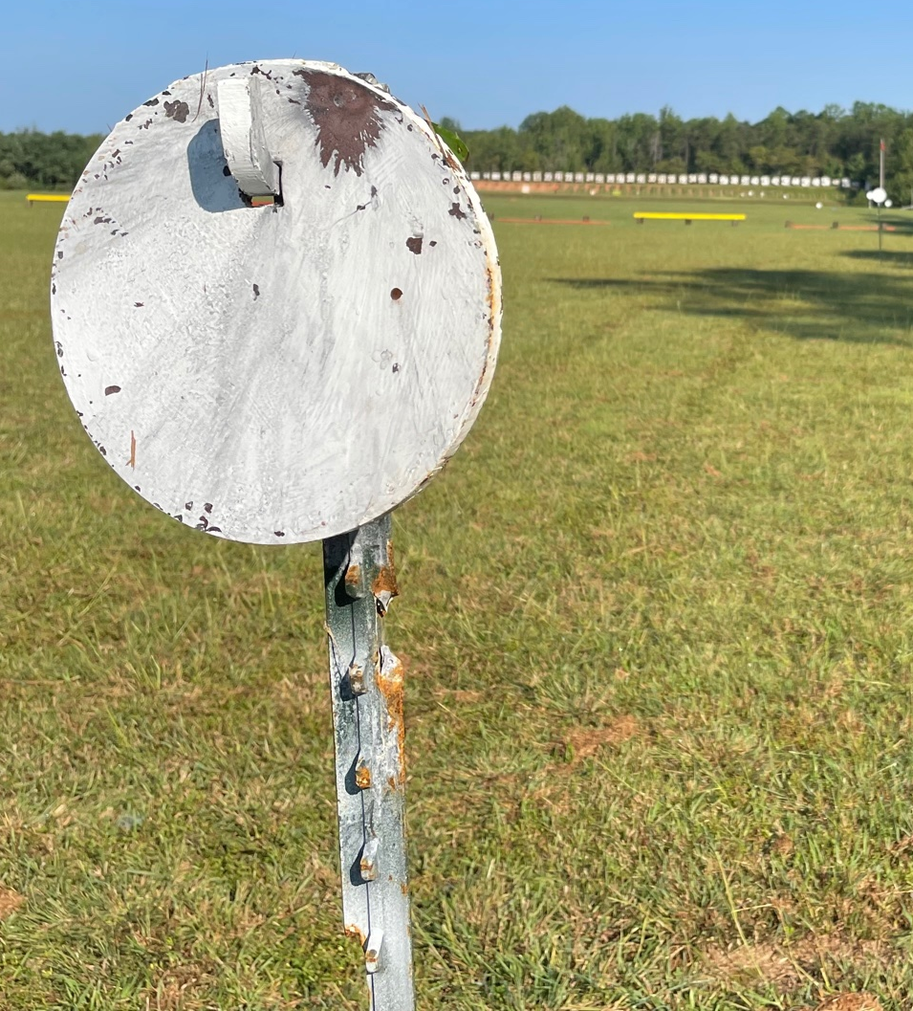
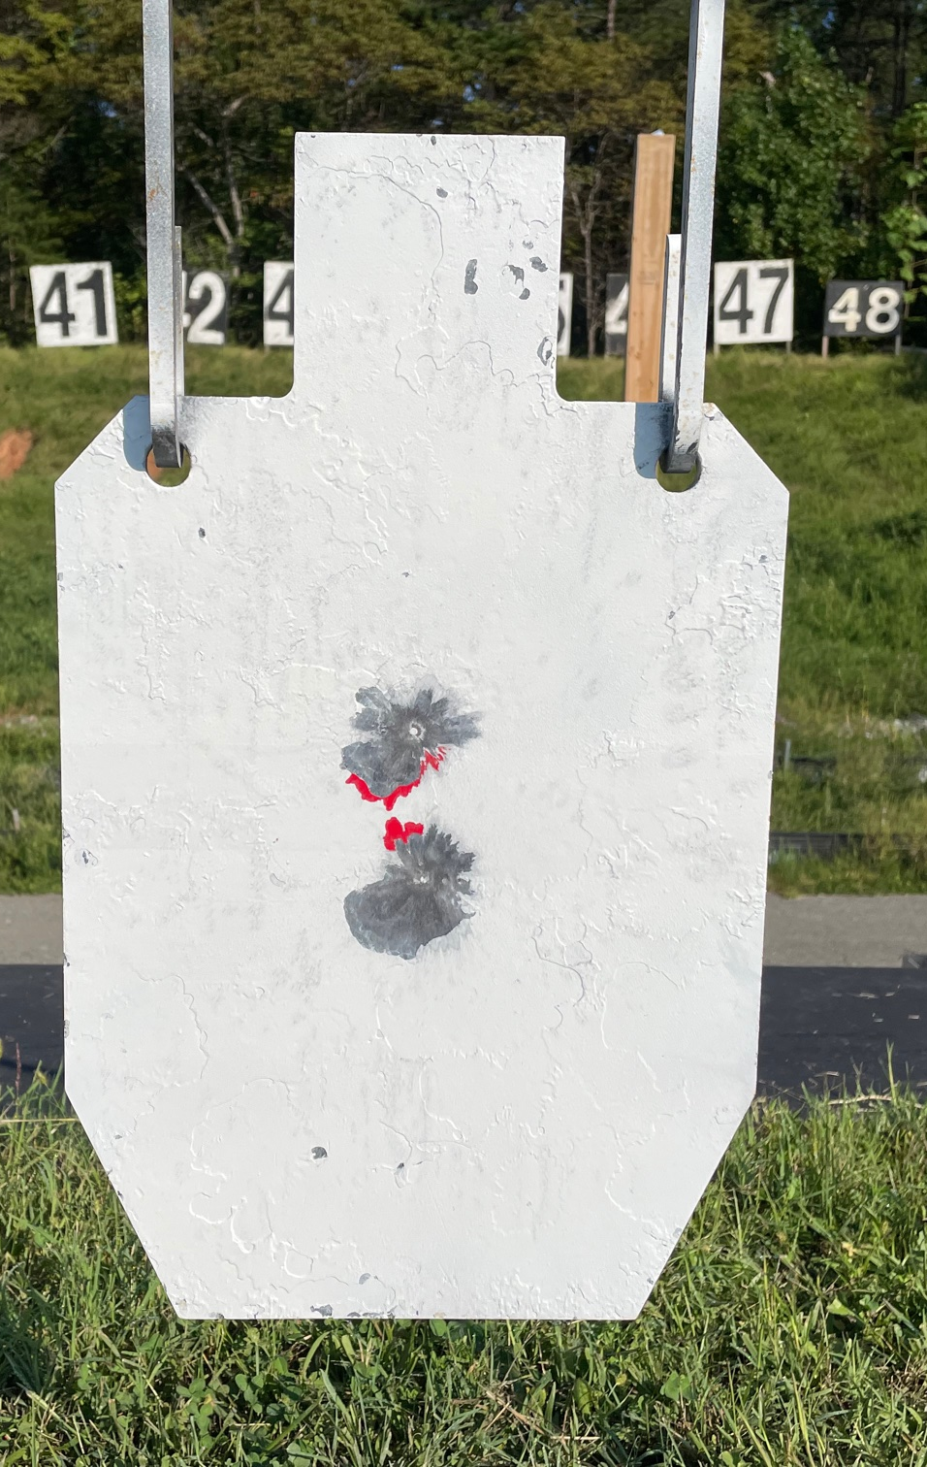
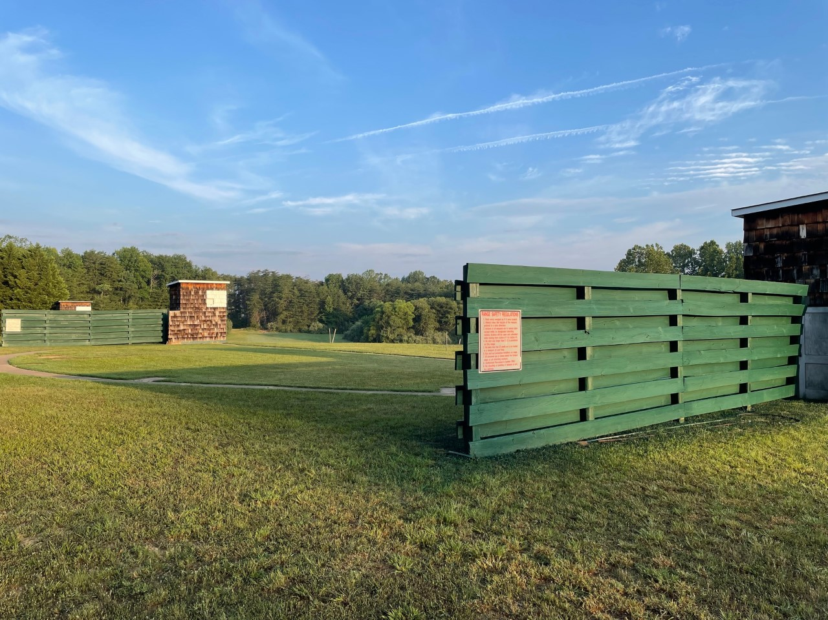
New Business – Board Projects

Slide 15
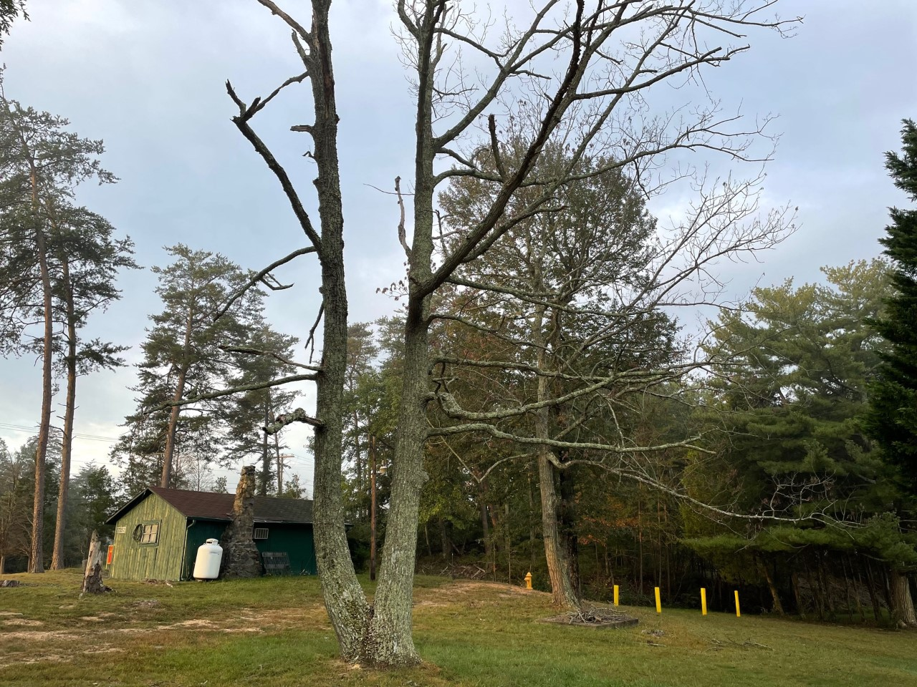
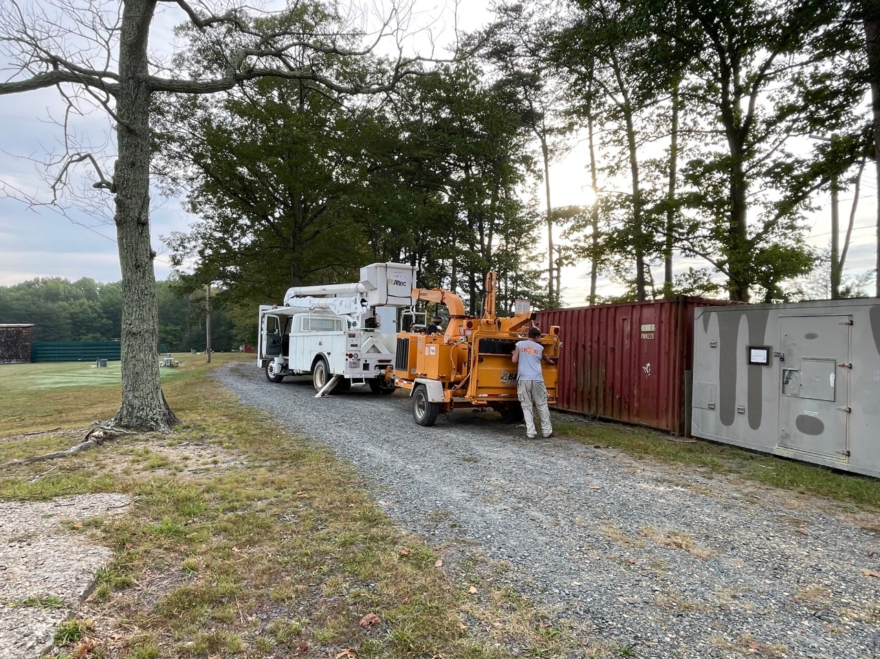
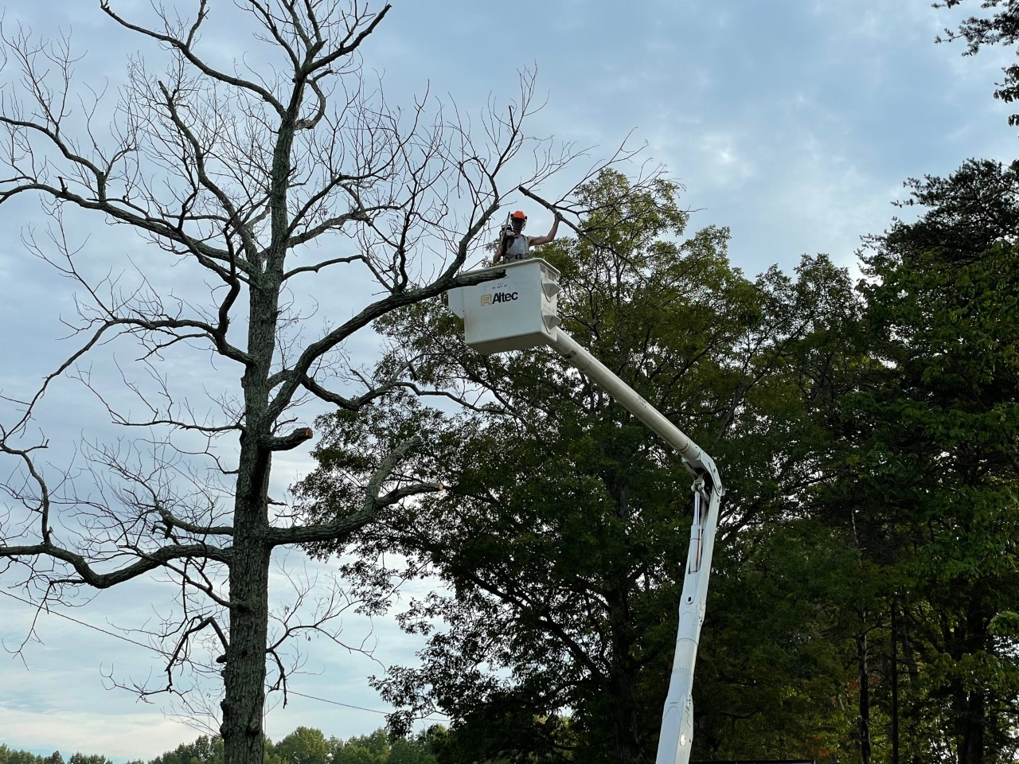
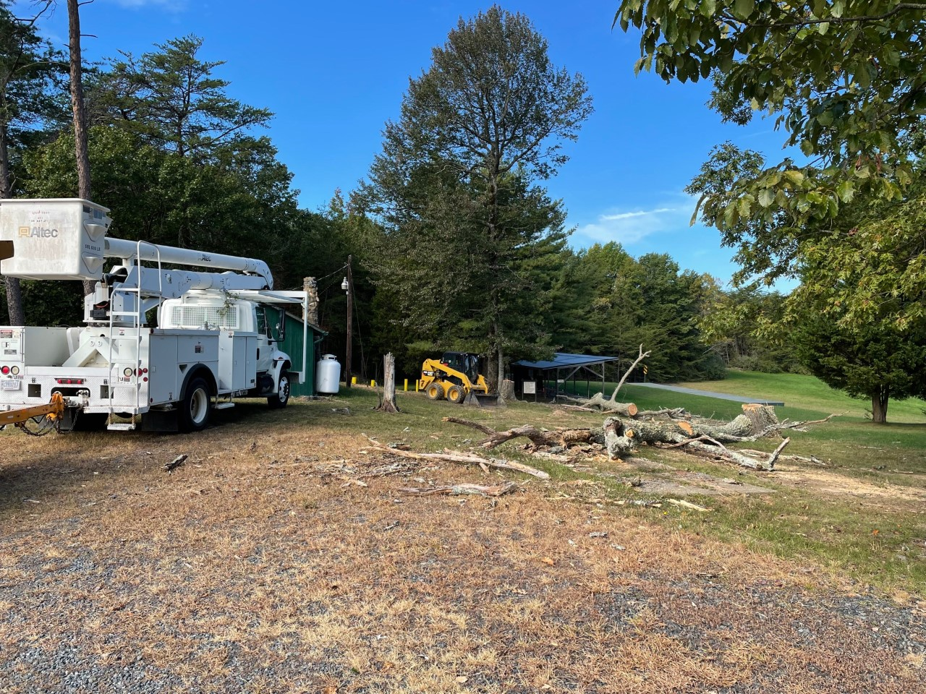
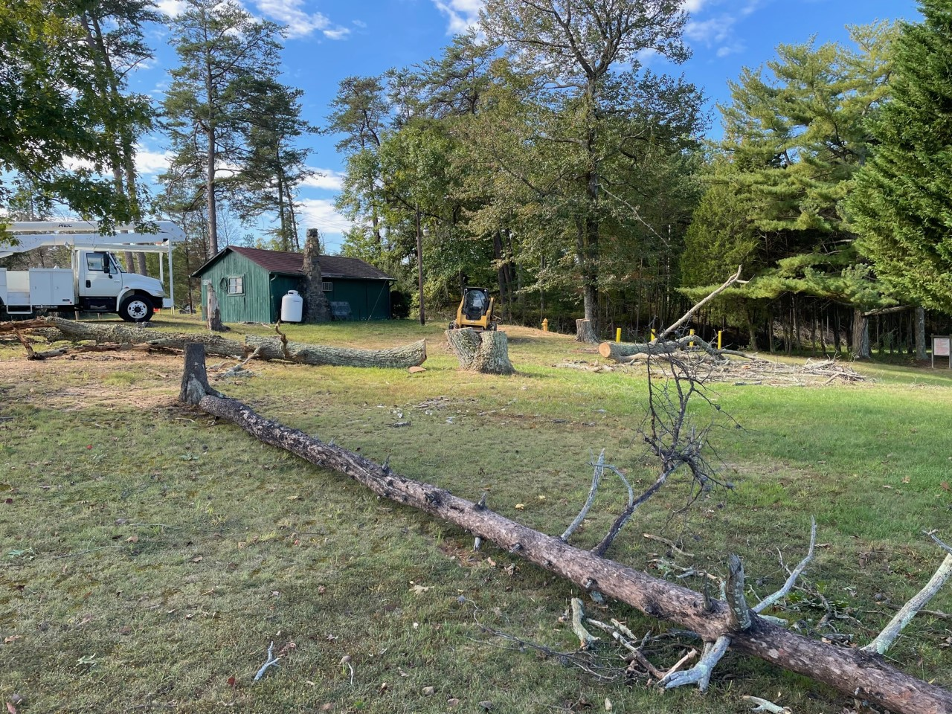
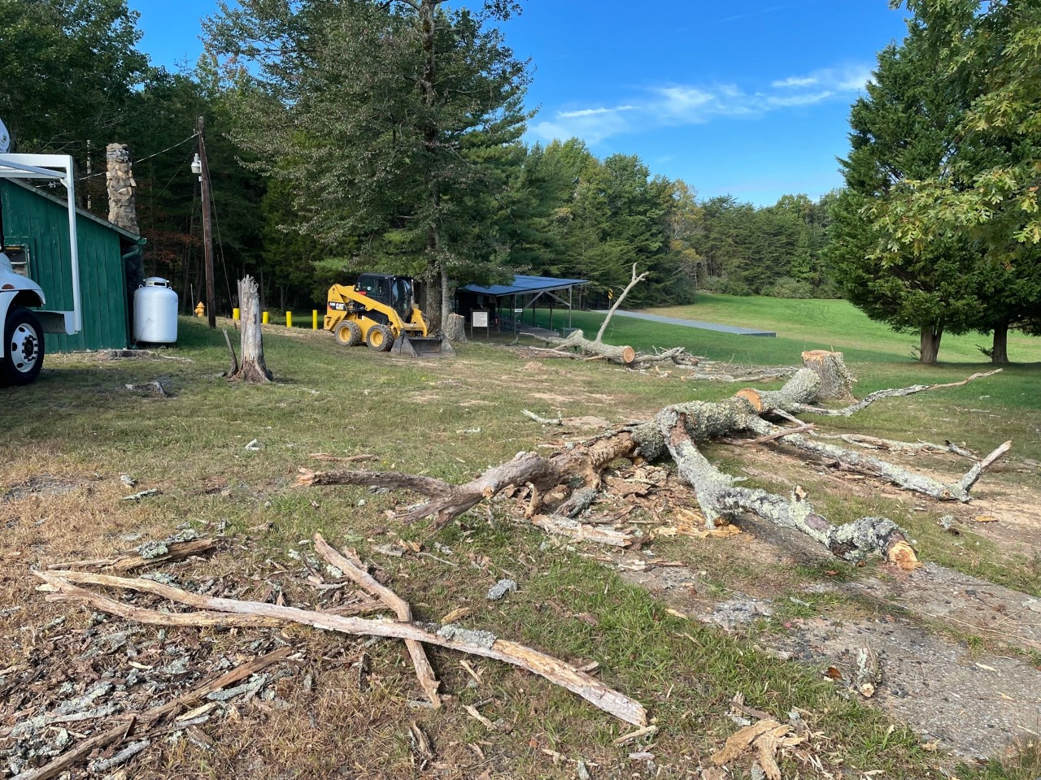
New Business – Board Projects

Slide 16
QSC Facility Maintenance Plan
10/16/2021
Quantico Shooting Club
15

Slide 17
New Business – Operations Report
Upcoming Range Issues:
  Range 1 rehabilitation project initiated by WTBN / Range Management and will continue throughout the remainder of the year. Will limit our access to the range and impact on recreational fire opportunities
  Target Pit Backstop Berm Remediation Project will start immediately following the Thanksgiving holiday and will close Ranges 1 through 4 though the end of the year
  USMC Marksmanship Team Matches during the weekend of 30-31 October will limit range availability. Check the QSC Website Calendar for availability
  Hunting season during the Fall months periodically impacts on range availability and high-power caliber usage

Slide 18
New Business – Operations Report
Upcoming Events:
  Steel Challenge – 17 October on SAT
  PRS Centerfire – 23 October on R4
  Sea Cadets – 23 October on SAT
  RSO In-Person Brief – 29 October at Range Control
  USMC Teams Shoot – 30/31 October (Limited Range Availability)
  PRS Rimfire/MARS – 6 November on Ironman
  USPSA – 13 November on SAT
  RSO In-Person Brief – 19 November at Range Control – Note Date Change due to Thanksgiving
  Steel Challenge – 21 November on SAT
  PRS Rimfire/MARS – 4 December on Ironman
  RSO In-Person Brief – 17 December at Range Control – Note Date Change due to Christmas
  USPSA – 18 December on SAT
  Steel Challenge – 19 December on SAT

Slide 19
New Business – Treasurer's Report
QSC Bank Accounts – Minimum Balances Set at $25K for Each Account for Club Solvency
  Checking:
    1 January 2020 = $18,722.76
    1 July 2020 = $22,091.40
    1 Oct 2020 = $31,267.33
    31 Dec 2020 = $39,750.90
    16 Apr 2021 = $62,806.66
    13 Jun 2021 = $67,938.68
    15 Oct 2021 = $69,838.28
  Savings (May be used for large, unexpected or capital expenses):
    1 January 2020 = $25,016.13
    1 July 2020 = $25, 022.30
    1 Oct 2020 = $25,024.54
    31 Dec 2020 = $25,026.44
    12 Apr 2021 = $25,028.30
    13 Jun 2021 = $25,030.18
    15 Oct 2021 = $25,032.18
10/16/2021
Quantico Shooting Club
18

Slide 20
New Business – Treasurer's Report
As a reminder, the QSC Must Pays:
Current liabilities:
  Annual Lease Payment - $5,000 – Usually due in September but QSC has not yet been billed
  Navy Administrative Fee - $5,000 – Supposedly billed to the USMC – Awaiting invoice to QSC
QSC Must Pays – Membership Cost Calculated at the Average Rate of $118
QSC Admin – 21hrs week = $19,656 annually = 167 Memberships | QSC EMT = $840 $1,050 monthly = $12,600 annually = 107 Memberships
QSC Insurance = $4,145 ($3,868) annually = 35 Memberships | QSC Clubhouse Lease = $5,000 = 43 Memberships
QSC Managed Web Services = $250 monthly = $3,000 annually = 25 Mbrs. | QSC Porta-John = $220 monthly = $2,640 annually = 23 Memberships
QSC Phone & Internet = $300 monthly = $3,600 annually = 31 Memberships | QSC Accountant = $417 monthly = $5,000 annually = 42 Memberships
QSC MS Office 365 = $55 monthly = $660 annually = 5 Membership | QSC Quickbooks = $40 monthly = $480 annually = 4 Memberships
Payroll Liability = $100 monthly = $1,200 = 10 memberships | QSC Lease Administration = $1,000 annually = 8 Memberships
Facility & Grounds Maintenance = $2,500 = 21 Memberships | Equipment / Repairs & Ops = $2,500 $5,000 annually = 42 Memberships
Must pays (club required operations) equal $41,805 or 354 $46,825 or 397 Paid Memberships Annually. This is down from the $61,184 / 518 reported in Jan 2021 but up $5,020 from the last quarter due to an increase in EMT and Operational costs driven by club improvement projects.

Slide 21
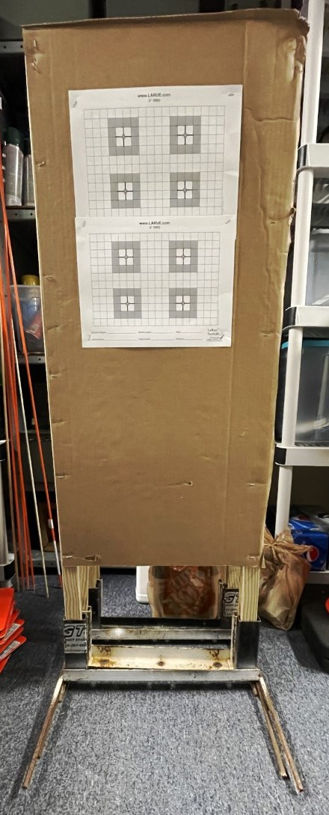
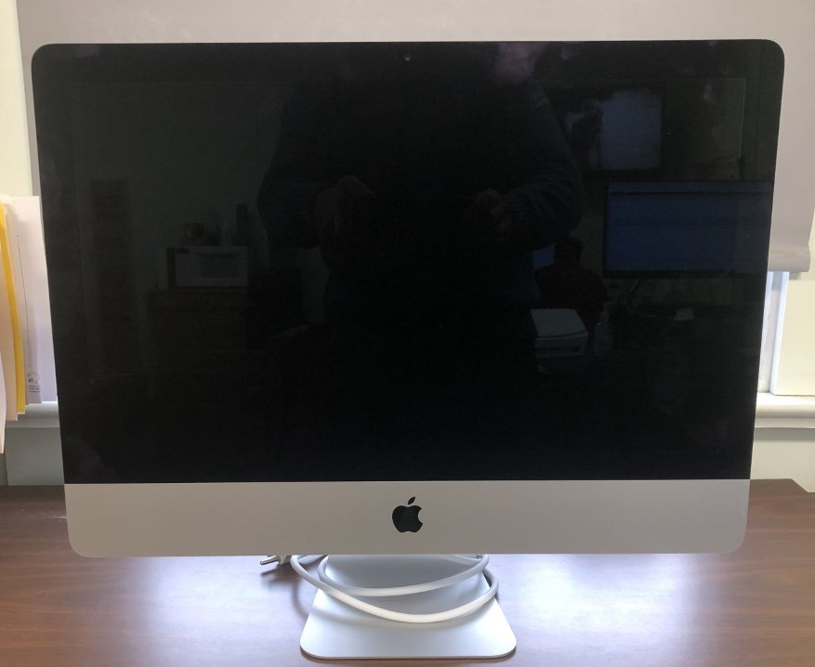
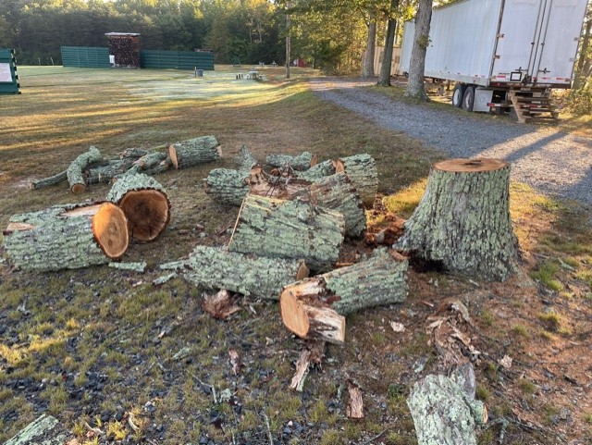
QSC Treasurer’s Report - Items For Sale
Apple iMac – Gently Used 21.5” – Bought new (Best Buy) in Apr 2020 and Used through Nov 2020 - $700
  Core I5 @ 2.3GHz, 8GB Memory with a 1TB hard drive
  QSC transitioned to Windows machines - Reset and is ready to go to a new home
  Fully functional, like new, includes keyboard and mouse, but no box
Target Stands – GT Targets metal frame with 1x2 uprights and cardboard backer - $20
Oak Firewood - Free
10/16/2021
Quantico Shooting Club
20

Slide 22
New Business – Secretary’s Report
Membership Report
 | April 2021 | May 2021 | June 2021 | July 2021 | August 2021 | September 2021 | October 2021
Regular Members | 899 (74%) | 972 (73%) | 976 (74%) | 1035 (74%) | 948 (75%) | 918 (75%) | 918 (75%)
Associate Members | 318 (26%) | 352 (27%) | 344 (26%) | 359 (26%) | 318 (25%) | 301 (25%) | 313 (25%)
TOTAL MEMBERS | 1217 | 1324 | 1320 | 1394 | 1266 | 1219 | 1232
  Membership ratio is well within the MCBQ directed 2/3 Regular – 1/3 Associate member requirements
  This time last year we had 1056 members. Today we have a membership of 1232. Roughly 14% growth.

Slide 23
New Business – RSO Report
RSOs are the lifeblood of the Club – Ranges don’t open without our RSOs
There are currently 82 certified RSOs
There are 5 club members with expired RSO certifications
RSO Volunteer Efforts (last 12 months):
  41 RSOs have opened 0-5 ranges
  16 RSOs have opened 6-10 ranges
  9 RSOs have opened 11-15 ranges
  6 RSOs have opened 16-20 ranges
  3 RSOs have opened 21-25 ranges
  1 RSO has opened 26-30 ranges
  3 RSOs have opened 31-35 ranges
  3 RSOs have opened >35 ranges
There are 12 members enrolled in the MarineNet CBT Basic Range Safety Course
There are 0 members currently waiting to attend to MCBQ OIC/RSO In-Person Brief
Notes:
Limiting factor on range openings is, of course, volunteer RSOs.
Range Management Branch requires a dedicated OIC & RSO on each range. Effectively meaning we need three – four RSOs per range.
92 range days available each year. (46 weekends)
15 RSOs haven’t opened a range in the past 12 months.

Slide 24
New Business – RSO Report
Range Utilization Report – July – September: 25 Weekend Days Available
  4 days – Range Control Closed (Holiday / No Unit Training) (16%)
  21 days – Ranges Open (84%)
Range Openings:
July - September: 61 Ranges Opened – 1,400 Members and our Guests enjoying shooting sports through the QSC
Recreational Fire:
  Range 1 (Rec Fire) – 5 days
  Range 2/3 (Rec Fire) – 4 days
  Range 4 (Rec Fire) – 15 days
  Range 305 (Rec Fire) – 7 days
  SAT Range (Rec Fire) – 3 days
  Shotgun (Rec Fire) – 8 days
Match Events:
  Range 1 (.22 PRS Match) – 4 days
  Range 3 (GSM / XTC / EIC Match) – 2 day
  Range 4 (PRS / Rifle Matches) – 3 days
  SAT Range (USPSA / SC Matches) – 10 days
  Shotgun (Matches) – 0 days
Notes:
77 weekend days available from January to September.
Ranges closed 30 days (28 outside our control) or 39% of the available time
Ranges opened 47 days or 61% of the available time
Board goal to have a General Purpose Range (like Range 1 or Range 305) open every weekend and we were very close to achieving that with a GP Range open 29 days
Other numbers speak for themselves

Slide 25
New Business – Match Report
QSC held 24 matches in 2020 and 2021 to date QSC has held 40 matches and cancelled 10 events
About 50% of revenue is reinvested through equipment and infrastructure improvements
2022 goals
  Continued self-sufficiency for each discipline – Match fees fund all activities with no further QSC investments
  Reduce re-investments to no more than 25% of match revenue – Use funds to further build club reserves
Notes:
Club has conducted 19 matches to date
USPSA and Steel Challenge are self-sustaining and part of their profits are covering expenses in other areas.
Objective is to have each shooting discipline cover their own expenses and to permit infrastructure sustainment and improvement where possible.
We cancelled our Trap and Skeet matches this year and with the clubs focus on improving the fields and throwers we hope to get matches up and running this spring.
Any questions?
Tim?
Shawn / Jim?
Jim Otto / Rich?
Matt?
Range 4 conducts its own match called the Milk Jug Challenge. Skip did you want to add anything at this point in the meeting?

Slide 26
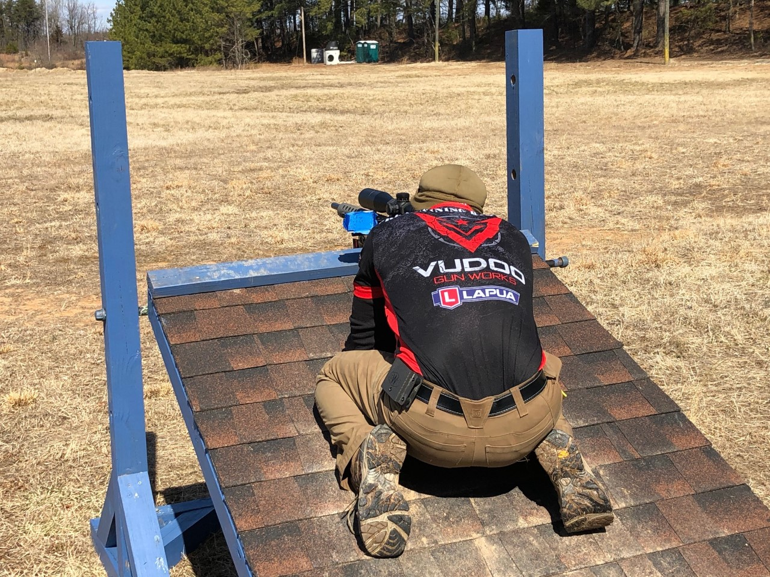
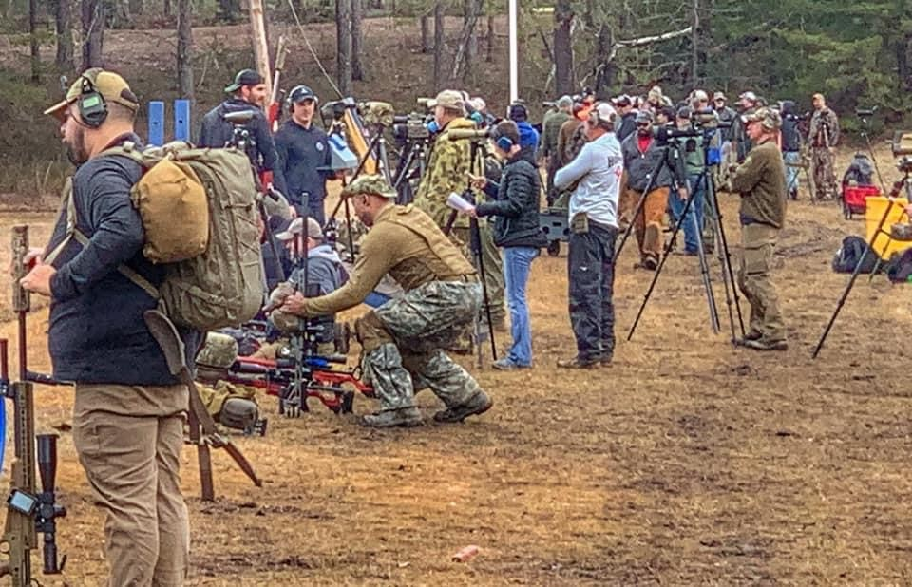
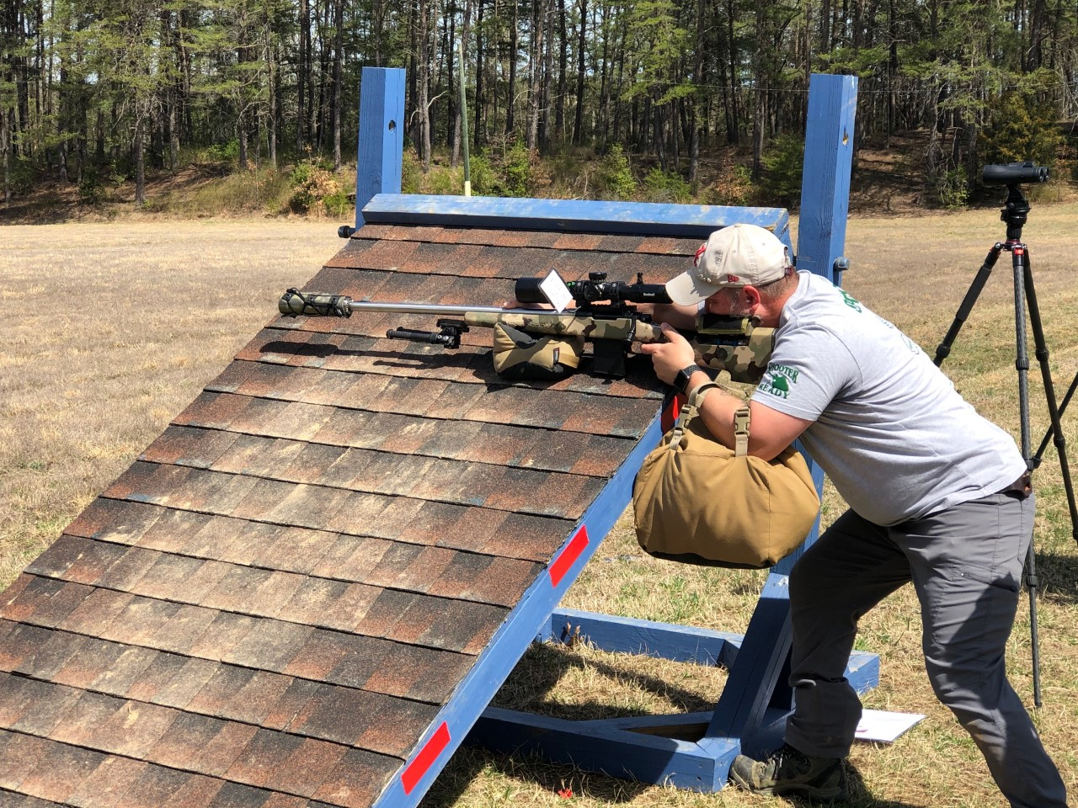
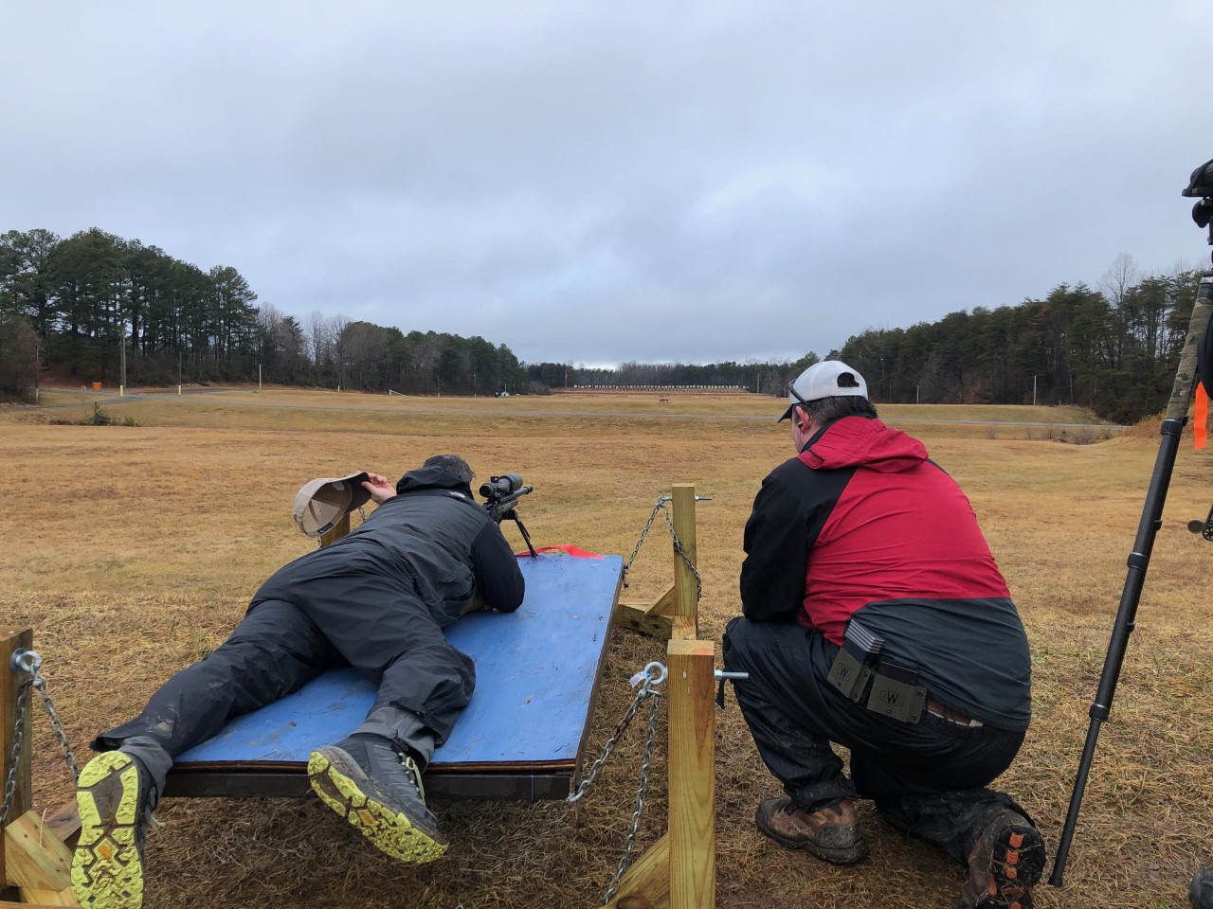
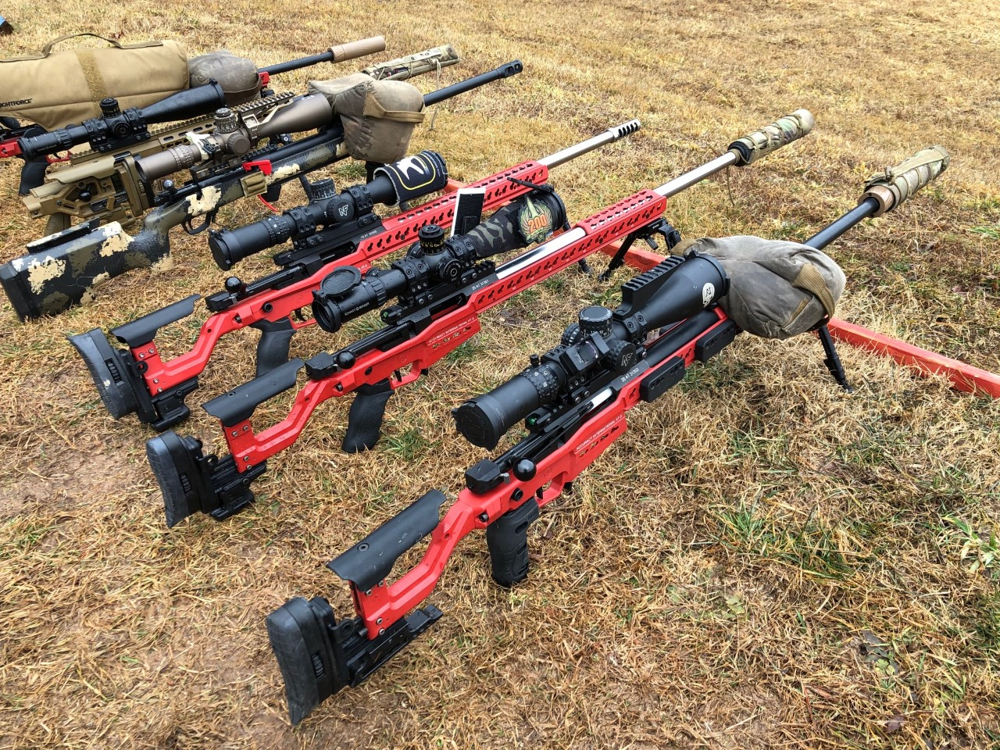
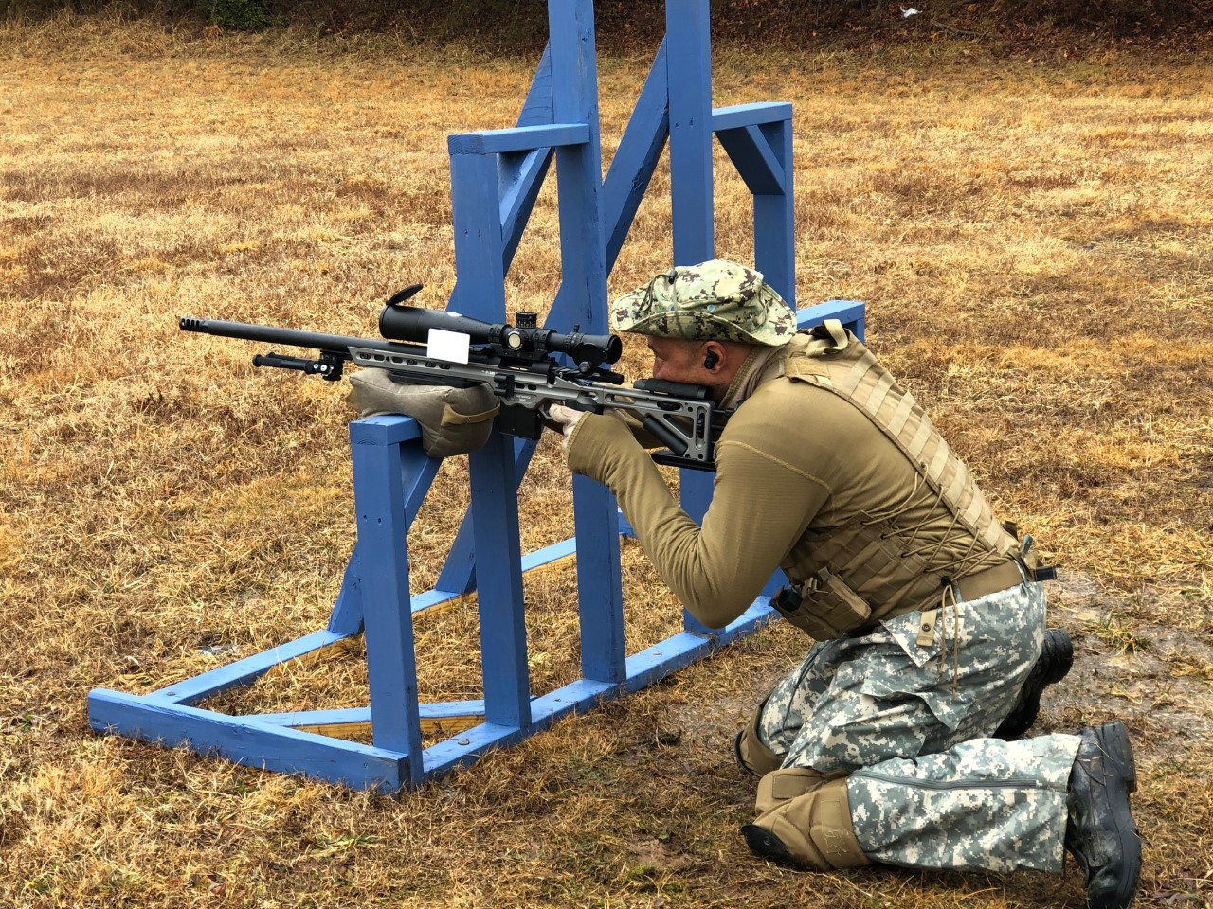
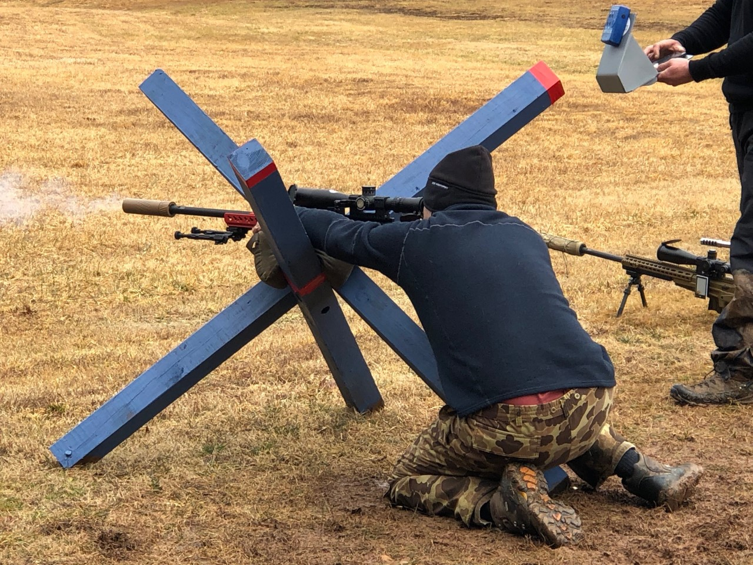
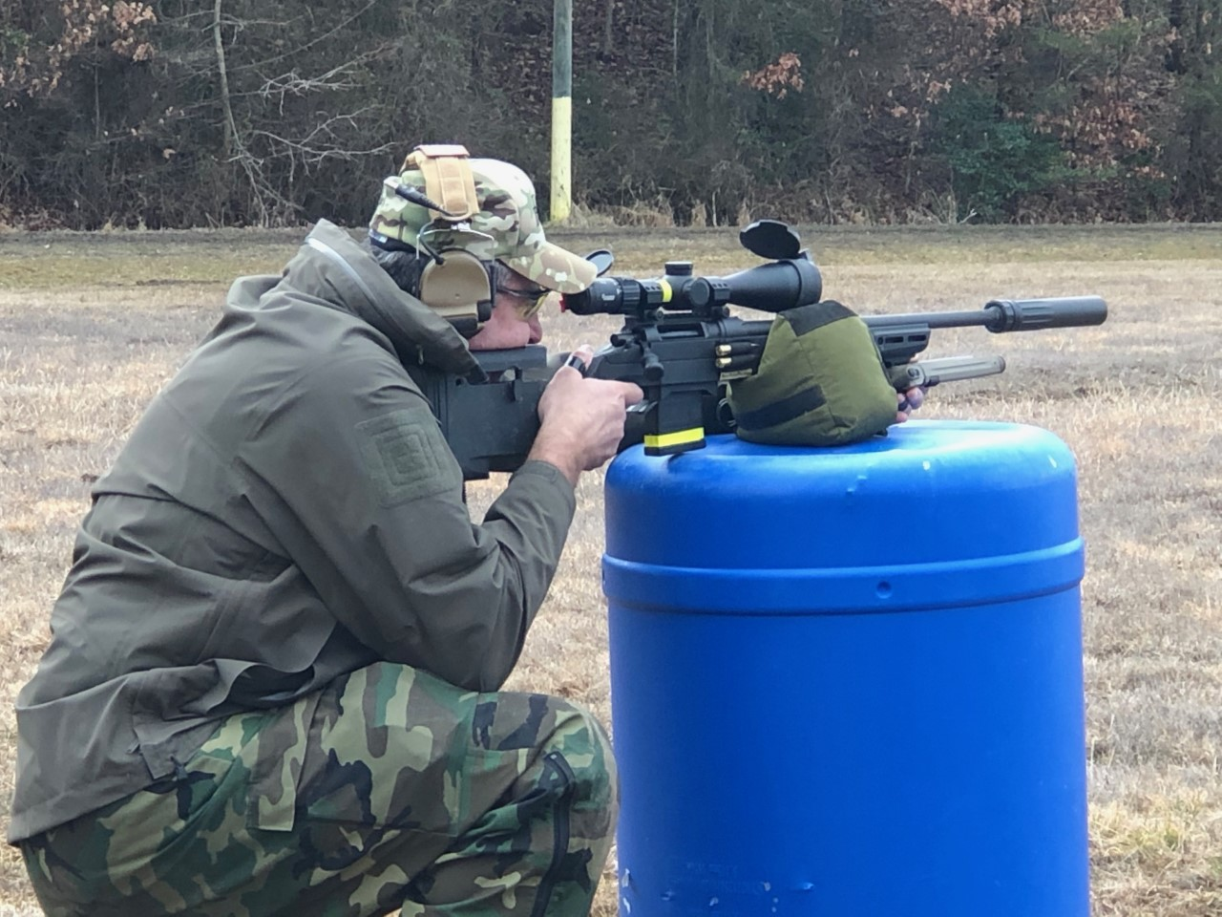

New Business – Match Report
  USPSA & Steel Challenge – Continues to enjoy success for QSC – Very positive marketing and on-line comments
  PRS Centerfire / Rimfire – Equally impressive during 2021 while increasing QSC name recognition – Massive local audience
    Participation has steadily increased in these matches – Word is getting out about QSC – Professional leadership and investments
    The exception is shotgun – recruiting efforts have not resulted in anyone stepping up to assume Field Director duties
10/16/2021
Quantico Shooting Club
25

Slide 27
New Business – Match Director Comments
USPSA – Tim Hichak
Steel Challenge – Kevin Shannon
PRS Centerfire – Tim Hichak
PRS Rimfire – Ken Freeman
Vintage Precision – Jim Otto
GSM – Rich Martinez
Shotgun – Still Seeking a Field Director
Notes:
The club continues to receive very positive comments regarding the professionalism and consistency of our marksmanship matches.
Attributable to the amount of effort from our volunteer match directors
Tim Hichak, Zach Basich – USPSA
Shawn Pratt, Jim Wisniewski – Steel Challenge
Jim Morgan, Jim Otto, Rich Martinez – Vintage Precision Rifle
Matt Gundlach - MultiGun

Slide 28
New Business – Member Discussions
New Business
  January Elections – Need a Person or Committee to spearhead the process
    Clint Anderson intends to run for re-election as the President
    John Monaccio intends to run for re-election as the Member-at-Large
    Anticipate vacancies for the Treasurer and Secretary, and potentially the Vice President
Member Discussions
  Open Forum
10/16/2021
Quantico Shooting Club
27

Slide 29
FINAL DISCUSSIONS
ANY SAVED ROUNDS?
10/16/2021
Quantico Shooting Club
28

Slide 30
Summary
Meeting Opened on time at 0800.
29 Club Members Present (Roster on File)
3 Board Members Present
  Clint Anderson (President)
  Lee Hilty (Secretary)
  John Monaccio (Member-At-Large)
2 Match Directors Present
  Kevin Shannon (Steel Challenge) – Discussed a proposal to host a SCSA State Match in October 2022.
  Jim Morgan (CMP / Vintage Sniper) – Discussed a proposal to host a Virginia Regional Match in June 2022.
Topics Raised by Members:
  Jon Couch – Raised topic of air gun shooting on QSC ranges. Volunteered to research MCBO / NRA rules and report back to the Board.
  Ellie Biddle – QSC should consider posting information about the club on the various Post/Base MWR websites to inform members of the multiple military communities of the club’s existence and purpose. BoD will review.
  Jon Couch – QSC should consider acquiring some manner of identifying RSOs on the ranges. T-Shirts or Caps would benefit members knowing the RSOs on the range in case of malfunctions or other situations requiring their attention. BoD has this on it’s task list to complete.
  John Monaccio asked the members if the briefing format was adequate. Response was that the briefing format was well accepted by the membership. No suggestions for additional information were provided at the meeting.
With no further business to discuss the meeting adjourned at 0940.
10/16/2021
Quantico Shooting Club
28

